Slide 1
How to evaluate output?
資料科學 Data Science
張家銘 Jia-Ming Chang
政治大學資訊科學系
The slide isonly for educational purposes. If any infringement, please contact me, we will correct immediately.

Slide 2
Copyright declaration 版權說明
Some of the figures in this presentation are taken from "An Introduction to Statistical Learning, with applications in R" (Springer, 2013) with permission from the authors: G. James, D. Witten, T. Hastie and R. Tibshirani.
The web site of the book
The credit of individual is indicated in the bottom part of the slide.
ie.,

Slide 3

Copyright declaration 版權說明
Some of the figures in this presentation are taken from "Practical Data Science with R (Manning, 2019)”
The web site of the book
The credit of individual is indicated in the bottom part of the slide.
ie.,

Slide 4

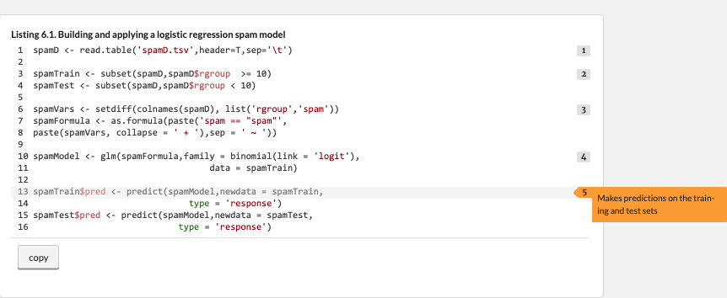
Very nice e-book, interactive!!!
https://www.manning.com/books/practical-data-science-with-r-second-edition

Slide 5
Copyright declaration 版權說明
Some of the figures in this presentation are taken from "R for Data Science” under the Creative Commons Attribution-NonCommercial-NoDerivs 3.0 License.
The web site of the book
The credit of individual is indicated in the bottom part.
ie.,

Slide 6
Data Science this week
Data Science Books
https://www.datascienceweekly.org/data-science-resources/data-science-books
A list of books covering Data Analysis, Data Science, Machine Learning, Data Visualization, Statistics & Associated Programming Languages

Slide 7
Recap from the last week

Slide 8
R language
Assignment : <- not =
&, | vs &&, ||
identical, all.equal
[[]] vs []
read_table()
summary()

Slide 9
Primary R data types
Numbers
Number Sequences
Vectors
Lists
Matrices
Data Frames
Factors
Null and NA
Which one is central data structure?

Slide 10
Source code management system
a distributed version control system
The development of Git began on 3 April 2005
Torvalds quipped about the name git, which is British English slang meaning "unpleasant person”.
http://git-scm.com/video/what-is-git
https://git-scm.com/downloads
https://git-scm.com/book/en/v2/Getting-Started-Installing-Git

Slide 11
Github
GitHub is a web-based Git repository hosting service.
Development of the GitHub platform began on 1 October 2007.
The site was launched in April 2008 by Tom Preston-Werner, Chris Wanstrath, and PJ Hyett after it had been made available for a few months prior as a beta period.
http://www.howtogeek.com/180167/htg-explains-what-is-github-and-what-do-geeks-use-it-for/

Slide 12
Example Code
Readthedocs
code03.zip
Run R script from command line
cd code03
Rscript <example>.R

Slide 13
Today
Practical Data Science with R by Nina Zumel and John Mount, (Manning, 2019)
Cha 05. Choosing and evaluating models
An Introduction to Statistical Learning with Applications in R﻿ by Gareth James, Daniela Witten, Trevor Hastie and Robert Tibshirani
Cha 02. Statistical Learning

Slide 14
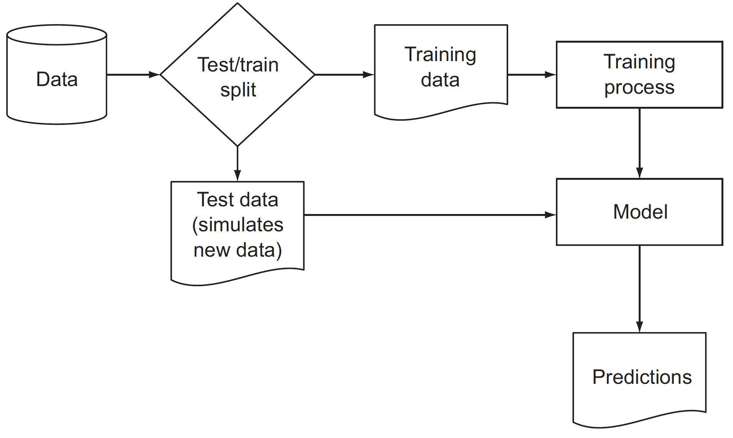
Schematic model construction and evaluation
Figure 5.1, Practical Data Science with R by Nina Zumel, John Mount

Slide 15
Schematic model construction and evaluation
model evaluation = quantifying the performance of a model that’s appropriate to both the original business goal and the chosen modeling technique.
a classification task (predicting who would default on loans)
Precision
recall
a probability task
a scoring task (predicting revenue lost to defaulting loans)
root mean square error (RMSE)
Practical Data Science with R by Nina Zumel, John Mount​

Slide 16
Model evaluation and critique
Is it accurate enough for your needs? Does it generalize well?
Does it perform better than “the obvious guess”? Better than whatever estimate you currently use?
Do the results of the model (coefficients, clusters, rules) make sense in the context of the problem domain?
Practical Data Science with R by Nina Zumel, John Mount

Slide 17
Outline
The accuracy of the Model
Evaluating models
Evaluating classification models
Covid-19 general sieve?
Multi-class classification
Evaluating scoring models
Evaluating probability models
Evaluating ranking models
Evaluating clustering models
Internal
External

Slide 18
The accuracy of the Model

Slide 19
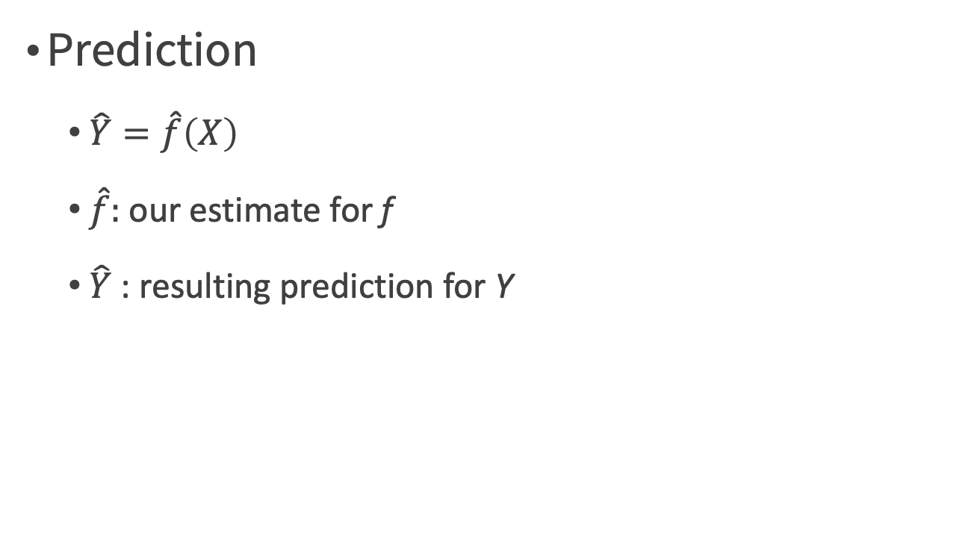
Why Estimate f?
Prediction
$\hat{Y}=\hat{f}\left(X\right)$
$\hat{f}:$ our estimate for f
$\hat{Y}$ : resulting prediction for Y
An Introduction to Statistical Learning with Applications in R by Gareth James, Daniela Witten, Trevor Hastie, Robert Tibshirani

Slide 20
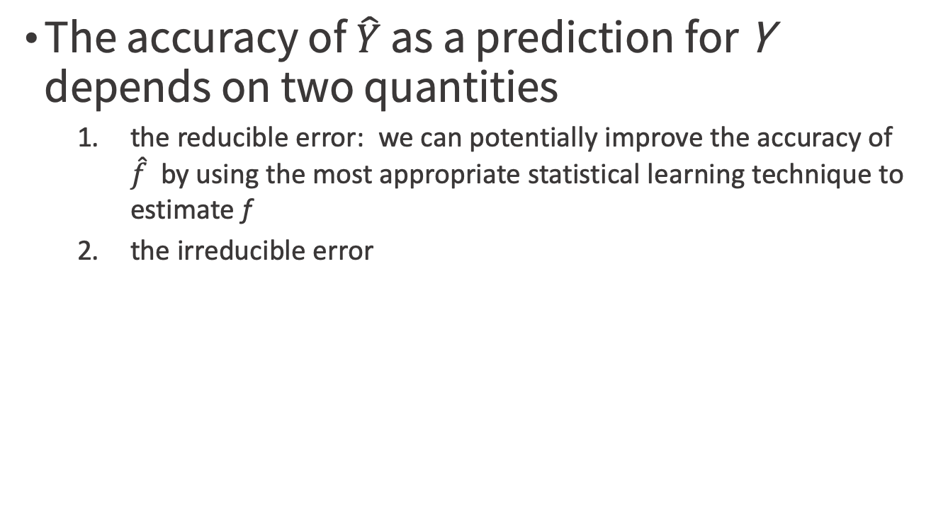

$$\hat{Y}=\hat{f}\left(X\right)$$
The accuracy of $\hat{Y}$ as a prediction for Y depends on two quantities
the reducible error: we can potentially improve the accuracy of $\hat{f}$ by using the most appropriate statistical learning technique to estimate f
the irreducible error
An Introduction to Statistical Learning with Applications in R by Gareth James, Daniela Witten, Trevor Hastie, Robert Tibshirani

Slide 21
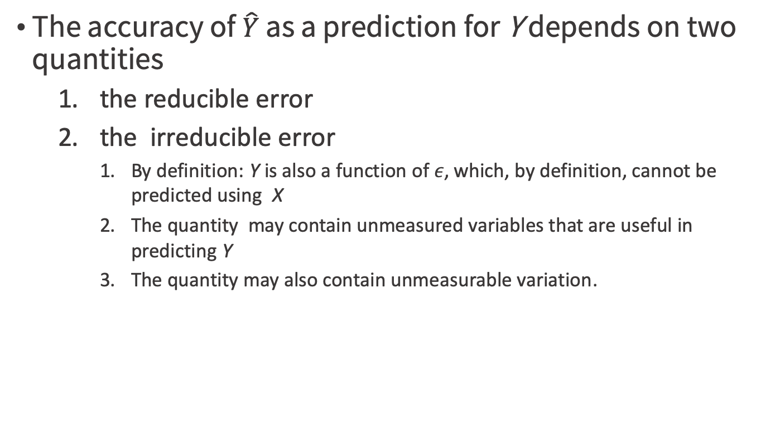
$$\hat{Y}=\hat{f}\left(X\right)$$
The accuracy of $\hat{Y}$ as a prediction for Y depends on two quantities
the reducible error
the irreducible error
By definition: Y is also a function of $ε$, which, by definition, cannot be predicted using X
The quantity may contain unmeasured variables that are useful in predicting Y
The quantity may also contain unmeasurable variation.
An Introduction to Statistical Learning with Applications in R by Gareth James, Daniela Witten, Trevor Hastie, Robert Tibshirani

Slide 22
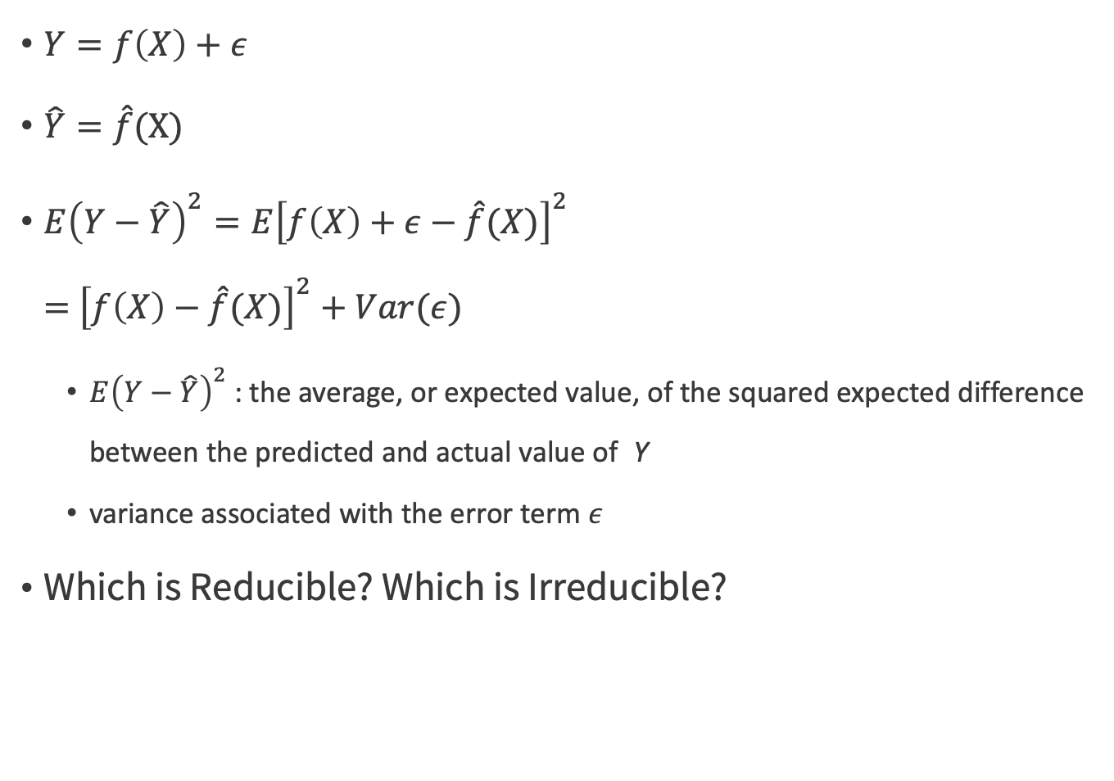
$Y=f\left(X\right)+ε$
$\hat{Y}=\hat{f}$(X)
$E{\left(Y−\hat{Y}\right)}^{2}=E{\left[f\left(X\right)+ε−\hat{f}(X)\right]}^{2}$ $=$ ${\left[f\left(X\right)−\hat{f}(X)\right]}^{2}+Var(ε)$
$E{\left(Y−\hat{Y}\right)}^{2}$: the average, or expected value, of the squared expected difference between the predicted and actual value of Y
variance associated with the error term $ε$
Which is Reducible? Which is Irreducible?
An Introduction to Statistical Learning with Applications in R by Gareth James, Daniela Witten, Trevor Hastie, Robert Tibshirani

Slide 23
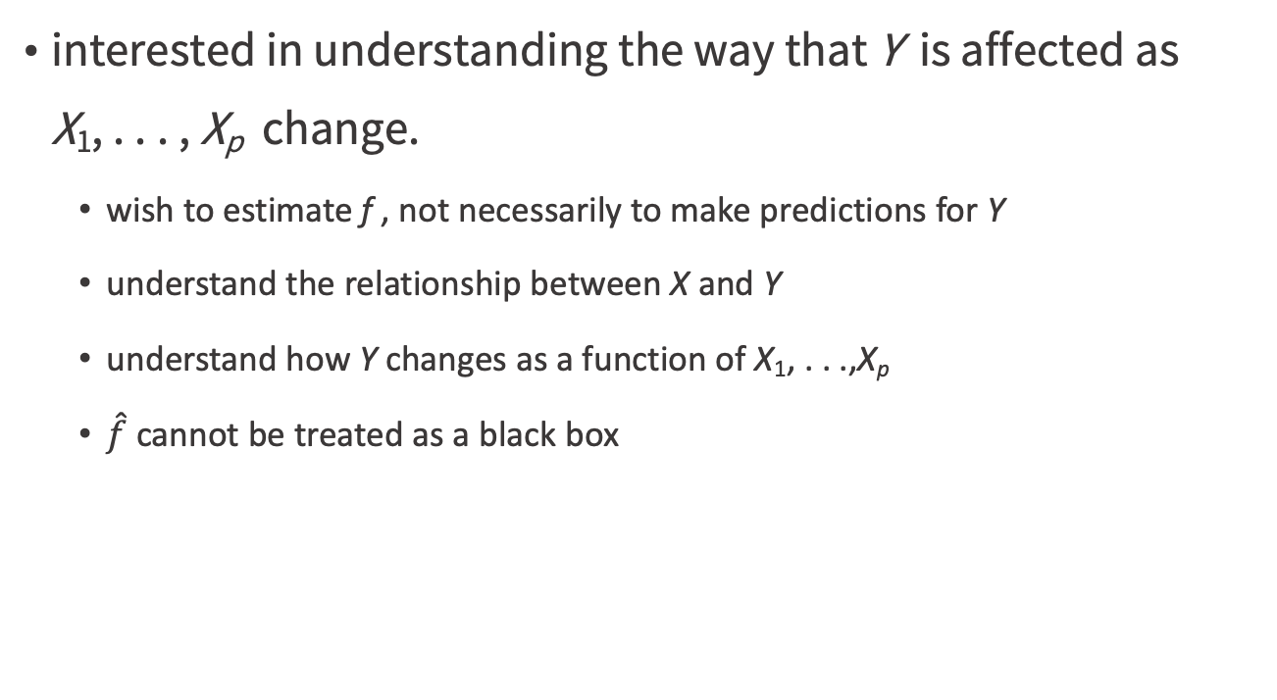
Inference v.s. Prediction
interested in understanding the way that Y is affected as X₁, . . . , X_{p} change.
wish to estimate f , not necessarily to make predictions for Y
understand the relationship between X and Y
understand how Y changes as a function of X₁, . . .,X_{p}
$\hat{f}$ cannot be treated as a black box
An Introduction to Statistical Learning with Applications in R by Gareth James, Daniela Witten, Trevor Hastie, Robert Tibshirani

Slide 24
Inference
Which predictors are associated with the response?
What is the relationship between the response and each predictor?
Can the relationship between Y and each predictor be adequately summarized
using a linear equation
the relationship more complicated?
An Introduction to Statistical Learning with Applications in R by Gareth James, Daniela Witten, Trevor Hastie, Robert Tibshirani

Slide 25
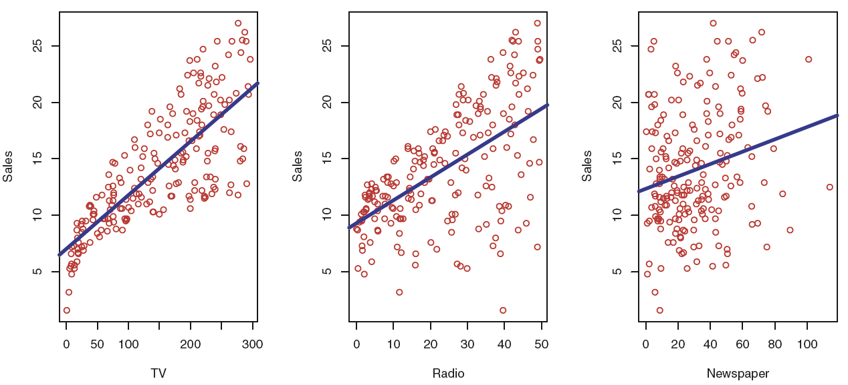
Inference
the Advertising data
Which media contribute to sales?
Which media generate the biggest boost in sales?
How much increase in sales is associated with a given increase in TV advertising?
Figure 2.1, An Introduction to Statistical Learning with Applications in R by Gareth James, Daniela Witten, Trevor Hastie, Robert Tibshirani

Slide 26
Evaluating models

Slide 27
Evaluating models
Classification
Scoring
Probability estimation
Ranking
Clustering

Slide 28
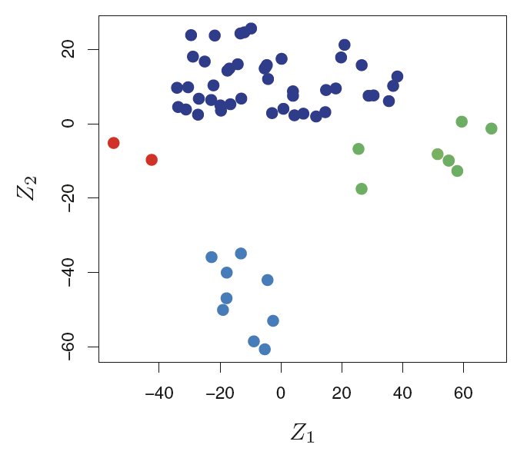
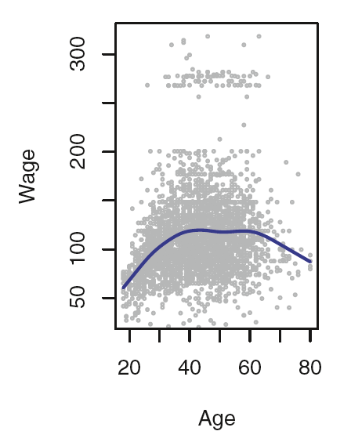
Regression v.s. Classification
quantitative : regression
qualitative : classification
Figure 1.4 & 1.1, An Introduction to Statistical Learning with Applications in R by Gareth James, Daniela Witten, Trevor Hastie, Robert Tibshirani

Slide 29
Evaluating classification models

Slide 30
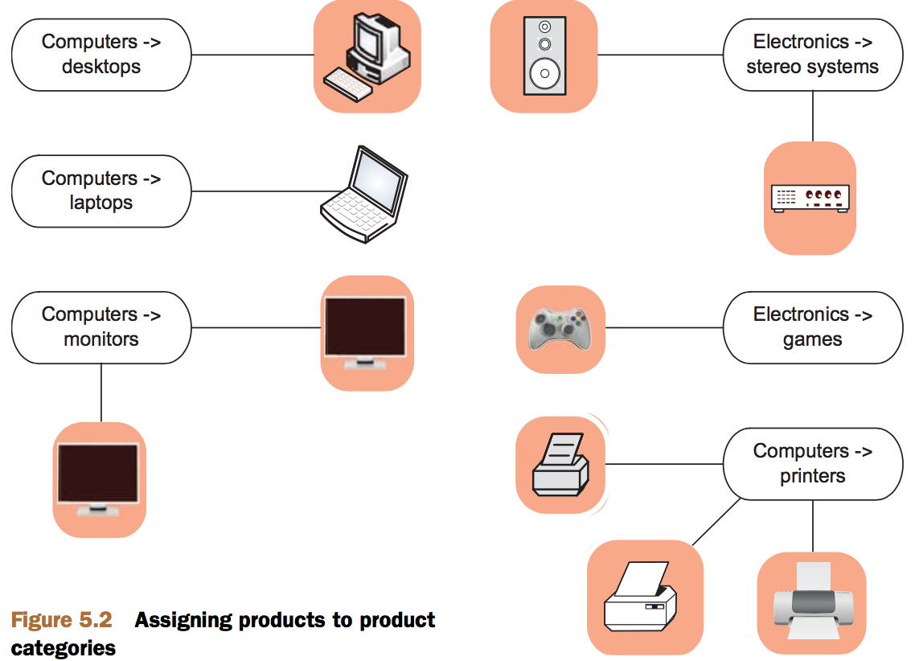
Assigning products to product categories
Figure 5.2, Practical Data Science with R by Nina Zumel, John Mount

Slide 31
Multicategory vs. two-category classification
using binary classifiers to solve multicategory problems
building one classifier for each category, called a one-versus-rest classifier
find a suitable multiple-category implementation
logistic regression : use the package mlogit instead of the base method glm
Practical Data Science with R by Nina Zumel, John Mount

Slide 32
Confusion matrix
A good summary of classifier accuracy is the confusion matrix
which tabulates actual classifications against predicted ones

Slide 33
Confusion matrix
confunsionMatrix.R
Step1: A decision tree model for finding bad loan applications
library('rpart')
load('GCDData.RData')
model <- rpart(Good.Loan ~ Duration.in.month + Installment.rate.in.percentage.of.disposable.income + Credit.amount + Other.installment.plans,
data=d, control=rpart.control(maxdepth=4),
method="class")
Practical Data Science with R by Nina Zumel, John Mount

Slide 34
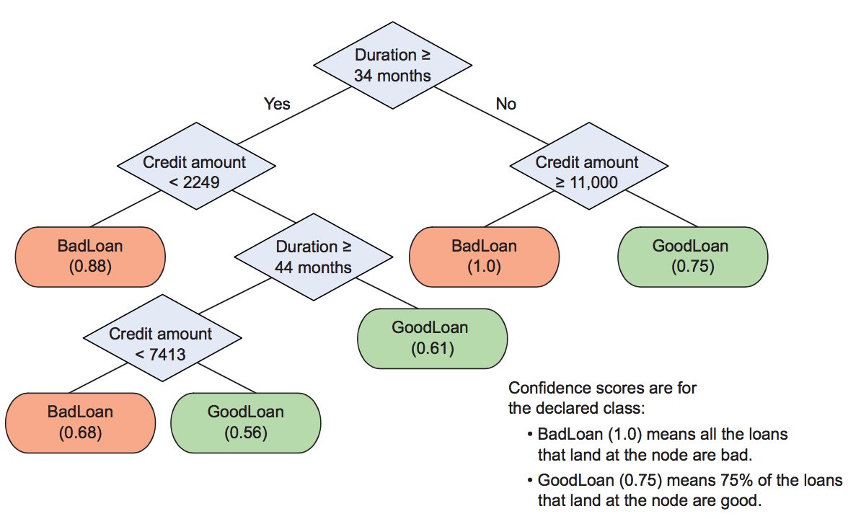
A decision tree
Figure 1.3, Practical Data Science with R by Nina Zumel, John Mount

Slide 35
Confusion matrix
Step2: plotting the confusion matrix
resultframe <- data.frame(Good.Loan=creditdata$Good.Loan,
pred=predict(model, type="class"))
(rtab <- table(resultframe))
Confusion matrix
Rows represent actual loan status
columns represent predicted loan status.
The diagonal entries represent correct predictions.
Practical Data Science with R by Nina Zumel, John Mount

Slide 36
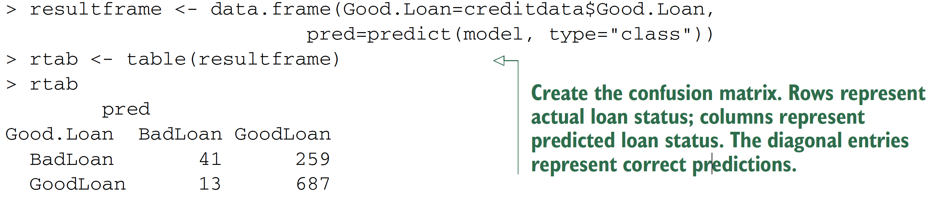
Confusion matrix
Practical Data Science with R by Nina Zumel, John Mount

Slide 37
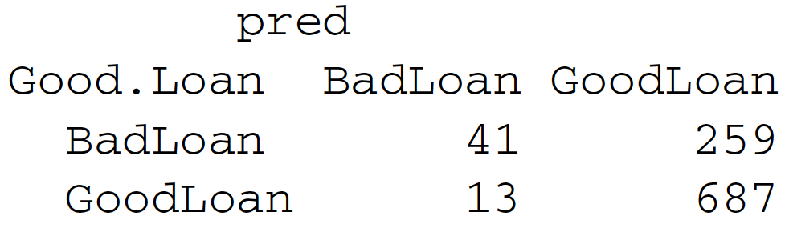
Evaluating classification models
Definition (BadLoan => positive case)
True positive
False positive
True negative
False negative
TP
FN
FP
TN
Practical Data Science with R by Nina Zumel, John Mount
Notes:
Why it important => show example to show some bias!

Slide 38
Evaluation
TP
FN
TP
FN
FP
TN
FP
TN
Accuracy
# of items categorized correctly divided by #of items
(TP+TN)/(TP+TN+FP+FN)
Precision
fraction of the items the classifier flags as being in the class actually are in the class = how often a positive indication turns out to be correct
TP/(TP+FP)
Recall
what fraction of the things that are in the class are detected by the classifier
TP/(TP+FN)
False positive rate = FP/(FP+TN)
Practical Data Science with R by Nina Zumel, John Mount
Notes:
Why it important => show example to show some bias!

Slide 39
Building and applying a logistic regression spam model
Spambase dataset ( http://mng.bz/e8Rh )
https://raw.githubusercontent.com/WinVector/zmPDSwR/master/Spambase/spamD.tsv
spamExam.R
# load data
spamD <- read.table('spamD.tsv',header=T,sep='\t')
spamTrain <- subset(spamD,spamD$rgroup>=10)
spamTest <- subset(spamD,spamD$rgroup<10)
spamVars <- setdiff(colnames(spamD),list('rgroup','spam'))
Practical Data Science with R by Nina Zumel, John Mount

Slide 40
Building and applying a logistic regression spam model
# build model
spamFormula <- as.formula(paste('spam=="spam"', paste(spamVars,collapse=' + '),sep=' ~ '))
spamModel <- glm(spamFormula,family=binomial(link='logit'), data=spamTrain)
Practical Data Science with R by Nina Zumel, John Mount

Slide 41
Building and applying a logistic regression spam model
# print predicted result
print(with(spamTest,table(y=spam,glmPred=pred>0.5)))
sample <- spamTest[c(7,35,224,327),c('spam','pred')]
print(sample)
Practical Data Science with R by Nina Zumel, John Mount

Slide 42
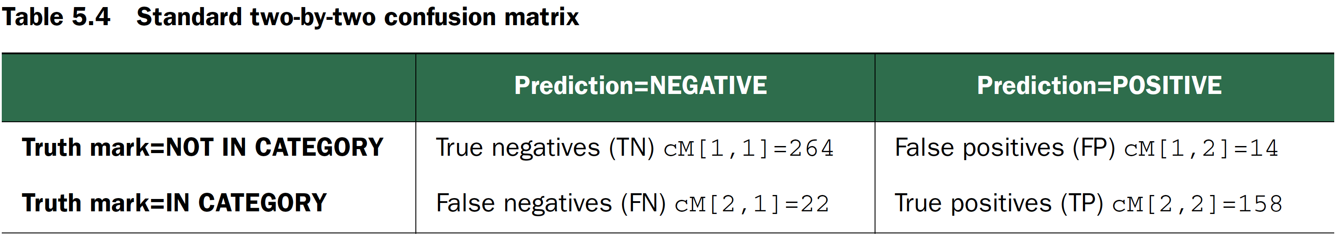
Spam confusion matrix
cM <- table(truth=spamTest$spam, prediction=spamTest$pred>0.5)
print(cM)
## prediction
## truth FALSE TRUE
## non-spam 264 14
## spam 22 158
Practical Data Science with R by Nina Zumel, John Mount

Slide 43
Changing a score to a classification
Picking thresholds other than 0.5 can allow the data scientist to trade precision for recall
(table(truth=spamTest$spam, prediction=spamTest$pred>0.9)) (table(truth=spamTest$spam, prediction=spamTest$pred>0.5)) (table(truth=spamTest$spam, prediction=spamTest$pred>0.1))
Practical Data Science with R by Nina Zumel, John Mount

Slide 44
Akismet filter
t <- as.table(matrix(data=c(288-1,17,1,13882-17),nrow=2,ncol=2))
rownames(t) <- rownames(cM)
colnames(t) <- colnames(cM)
print(t)
Practical Data Science with R by Nina Zumel, John Mount

Slide 45
Precision and Recall
Precision & Recall
Spam data?
Akismet filter?
Precision is a measure of confirmation
when the classifier indicates positive, how often it is in fact correct.
Recall is a measure of utility
how much the classifier finds of what there actually is to find.
spam filtering application, which one is important?
precision is emphasized over recall
Practical Data Science with R by Nina Zumel, John Mount

Slide 46
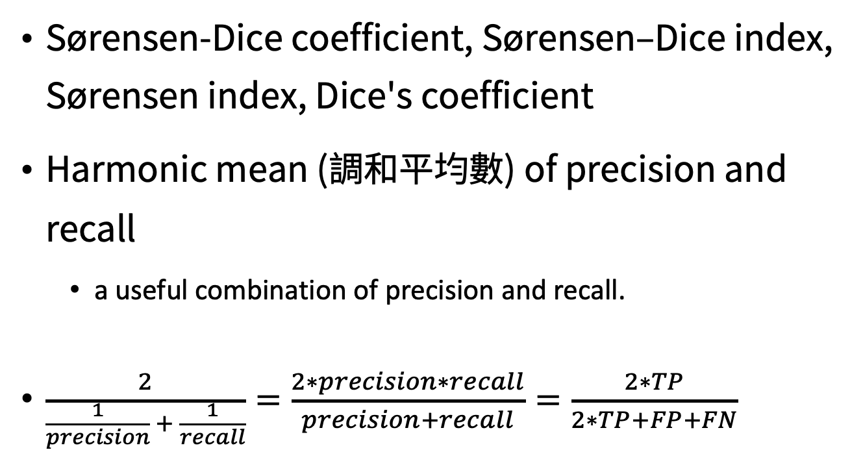
The F1 score
Sørensen-Dice coefficient, Sørensen–Dice index, Sørensen index, Dice's coefficient
Harmonic mean (調和平均數) of precision and recall
a useful combination of precision and recall.
$\frac{2}{\frac{1}{precision} + \frac{1}{recall}}=\frac{2∗precision∗recall}{precision+recall}=\frac{2∗TP}{2∗TP+FP+FN}$
Practical Data Science with R by Nina Zumel, John Mount

Slide 47
Accuracy
Accuracy
Spam data?
Akismet filter?
Accuracy is an inappropriate measure for unbalanced classes
a situation where we have a rare event (say, severe complications during childbirth)
the null model—the rare event never happens— is very accurate
different costs of “type I” and “type II” errors
Practical Data Science with R by Nina Zumel, John Mount

Slide 48
Type I and Type II errors
null hypothesis = the message is not a spam
a type I error : the rejection of a true null hypothesis
a type II error : the non-rejection of a false null hypothesis
Type I error : Spam filtering or spam blocking techniques wrongly classify a legitimate email message as spam.
Type II error : Spam email is not detected as spam, but is classified as non-spam.
Credit by https://en.wikipedia.org/wiki/Type_I_and_type_II_errors

Slide 49
Different costs of type I and type II errors?
null hypothesis = the message is not a spam
the null model: the rare event never happens => predict all mails are spam mails !
Bad in Type I or Type II error?
null model
truth FALSE TRUE
non-spam 0 288
spam 0 13882

Slide 50
spam filtering application, which one is important?
Precision vs Recall
precision is emphasized over recall
Type I vs Type II
Type I error is more critical than Type II error
Practical Data Science with R by Nina Zumel, John Mount

Slide 51
Sensitivity and Specificity
Sensitivity = the true positive rate = recall
Spam data?
Akismet filter?
Specificity = the true negative rate
TN/(TN+FP)
Spam data?
Akismet filter?
Why use those two terms?
null classifiers always return a zero score on either sensitivity or specificity.
Practical Data Science with R by Nina Zumel, John Mount

Slide 52
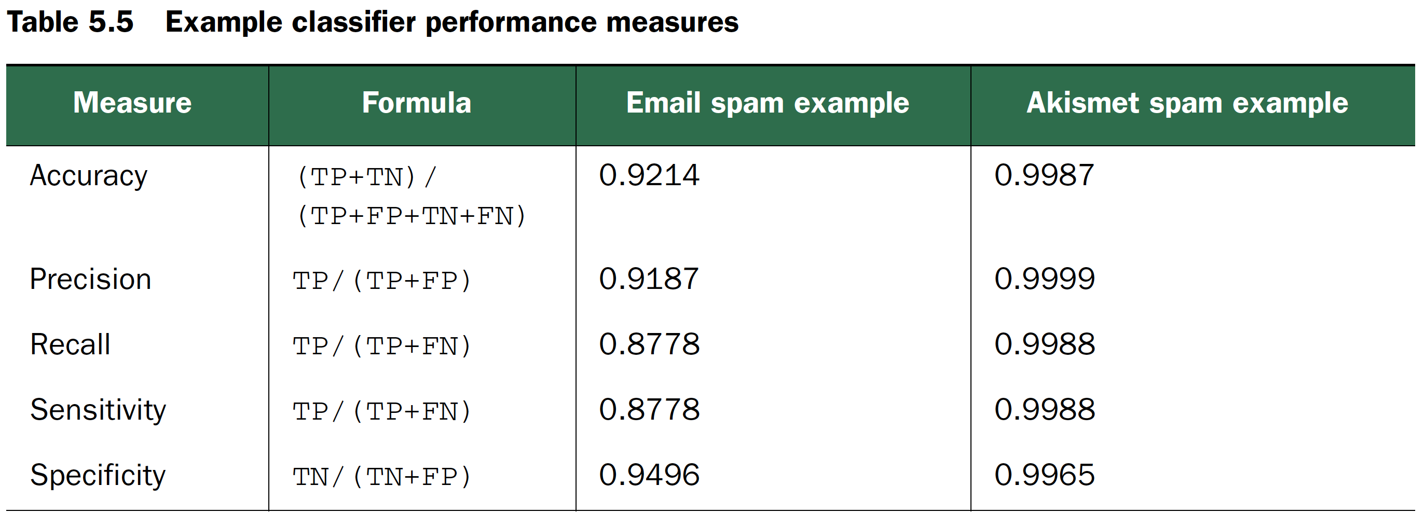
Common classification performance measures
Practical Data Science with R by Nina Zumel, John Mount

Slide 53
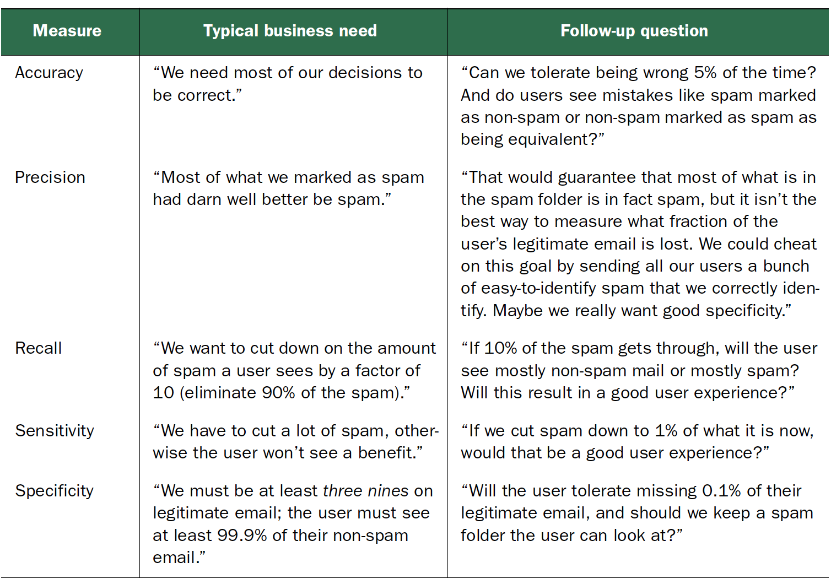
Classifier performance measures business stories
Practical Data Science with R by Nina Zumel, John Mount

Slide 54
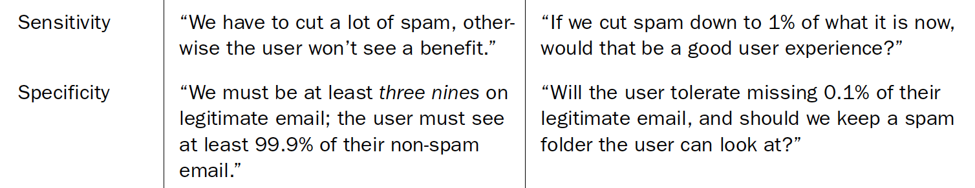
Common classification performance measures
Recommend writing the business goals as maximizing sensitivity while maintaining a specificity of at least 0.999
Recommend writing the business goals as maximizing specificity while maintaining a of sensitivity at least 0.999
Practical Data Science with R by Nina Zumel, John Mount

Slide 55
Covid-19 general sieve?
Based on 2020/04/28

Slide 56

Prevalence $π$
Prevalence = positive / all
Sensitivity & specificity
prevalence-independent test characteristics, as their values are intrinsic to the test and do not depend on the disease prevalence in the population of interest.
Positive & negative predictive value
values influenced by the prevalence of disease in the population that is being tested.
Credit by https://en.wikipedia.org/wiki/Sensitivity_and_specificity

Slide 57
A new test has been developed to diagnose HIV
Calculation of predictive value at 50% prevalence, gold standard
Test+ve : 1000
Test-ve : 1000
Sensitivity = 900/1000 = 90.0%
Specificity = 950/1000 = 95.0%
Positive Predictive Value (PPV, Precision) = 900/950 = 94.7%
Negative Predictive Value = 950/1050 = 90.5%
Credit by Indian J Ophthalmol. 2008 Jan-Feb; 56(1): 45–50. Understanding and using sensitivity, specificity and predictive values

Slide 58
Prevalence is 1% (=10,000/10,00,000)
Sensitivity = 9000/10000 = 90.0%
Specificity = 940500/990000 = 95.0%
PPV = 9000/58500 = 15.4%
Negative Predictive Value = 940500/941500 = 99.9%
Credit by Indian J Ophthalmol. 2008 Jan-Feb; 56(1): 45–50. Understanding and using sensitivity, specificity and predictive values

Slide 59
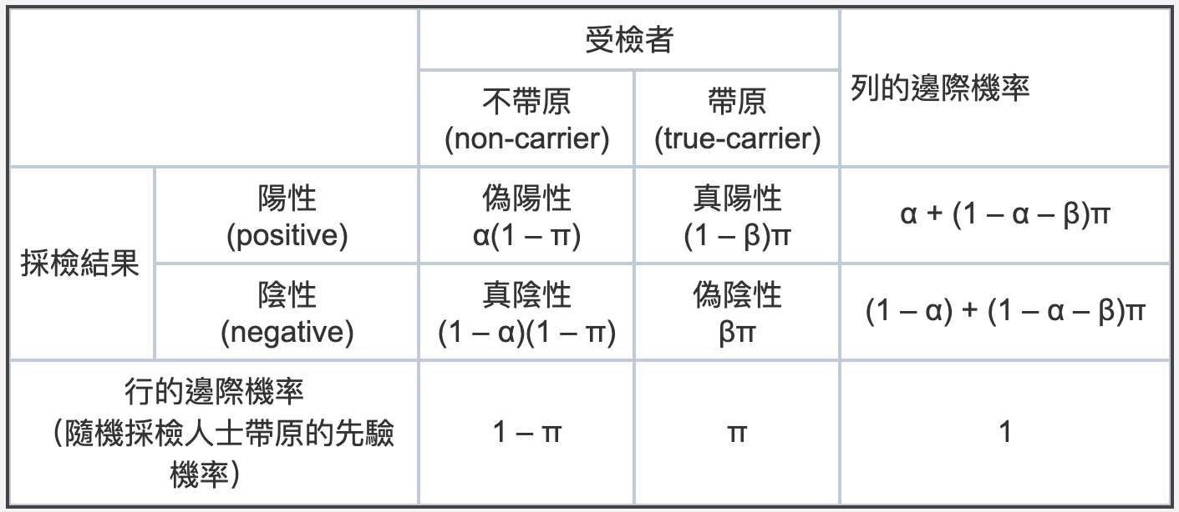
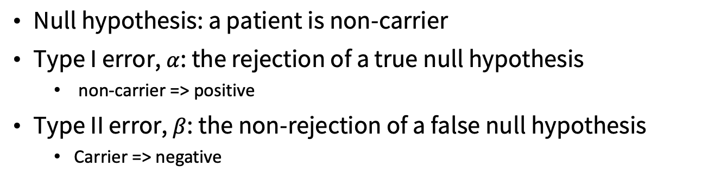

Type I ($α$), II ($β$) error
Null hypothesis: a patient is non-carrier
Type I error, $α$: the rejection of a true null hypothesis
non-carrier => positive
Type II error, $β$: the non-rejection of a false null hypothesis
Carrier => negative
Credit by 林澤民, https://pansci.asia/archives/184694

Slide 60
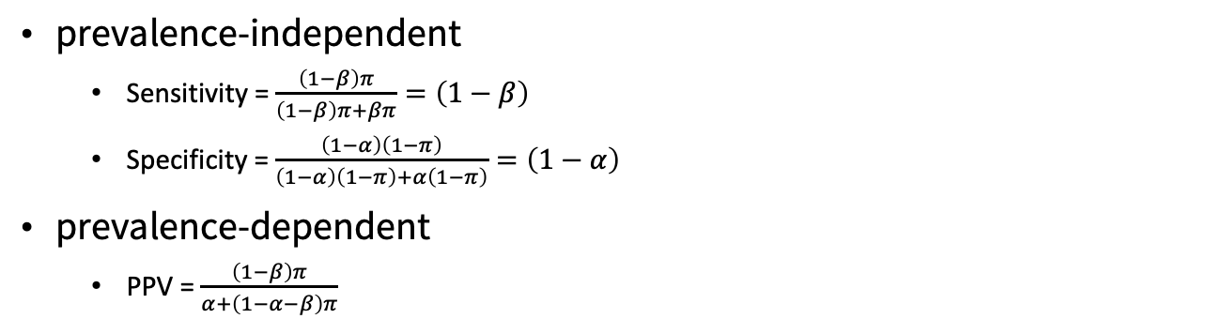
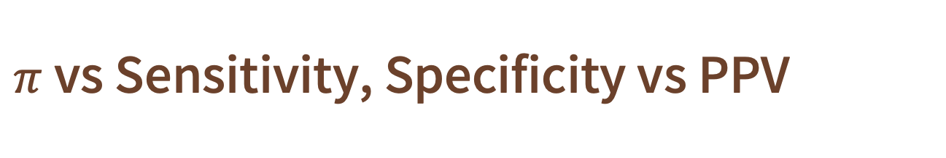
$π$ vs Sensitivity, Specificity vs PPV
prevalence-independent
Sensitivity = $\frac{\left(1−β\right)π}{\left(1−β\right)π+βπ}=\left(1−β\right)$
Specificity = $\frac{\left(1−α\right)\left(1−π\right)}{\left(1−α\right)\left(1−π\right)+α\left(1−π\right)}=\left(1−α\right)$
prevalence-dependent
PPV = $\frac{\left(1−β\right)π}{α+\left(1−α−β\right)π}$
Credit by 林澤民, https://pansci.asia/archives/184694

Slide 61
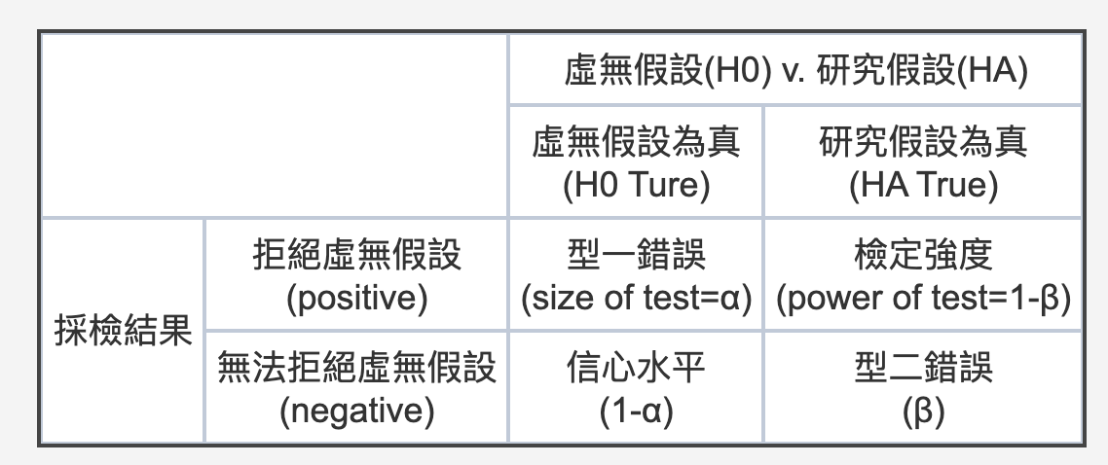
Specificity = 真陰性的機率 = 信心水平 = 1 – α
Sensitivity = 真陽性的機率 = 檢定強度 = 1 – β

Slide 62
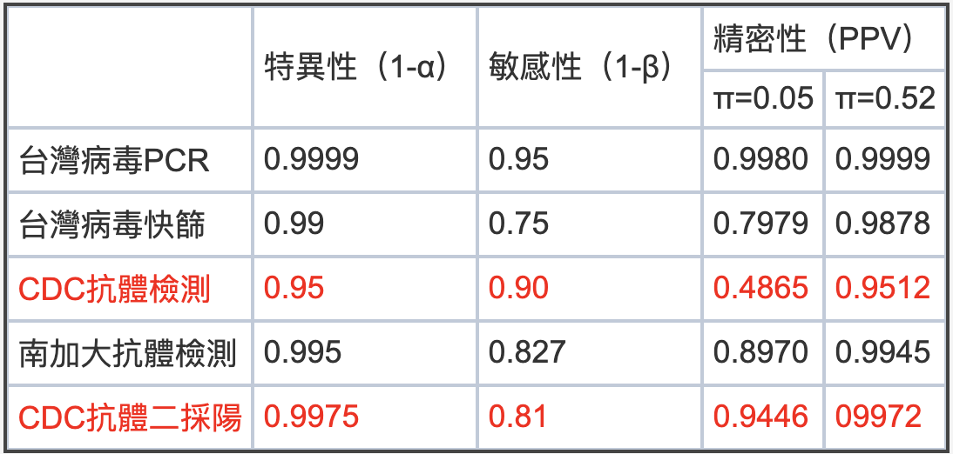
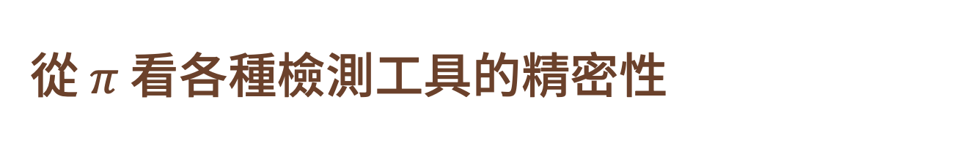
從$π$看各種檢測工具的精密性
PPV=0.4865 是什麼概念？
抗體檢測為陽性者，48.65% 是真帶原者， 偽陽性 > 50%
如果抗體施測單位所獲得的試劑品質不高怎麼辦？
specificity
sensitivity
Credit by 林澤民 https://pansci.asia/archives/186627

Slide 63
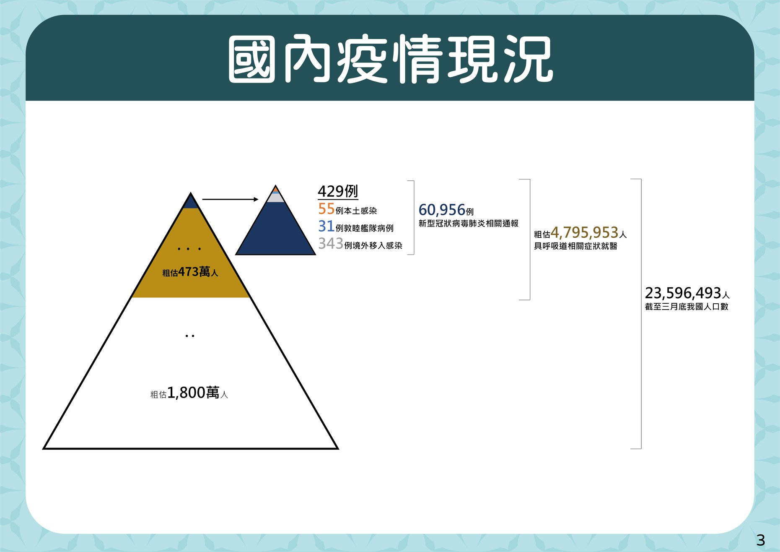
Credit by 疾病管制署 - 1922防疫達人https://www.facebook.com/TWCDC/posts/10158094507103407

Slide 64
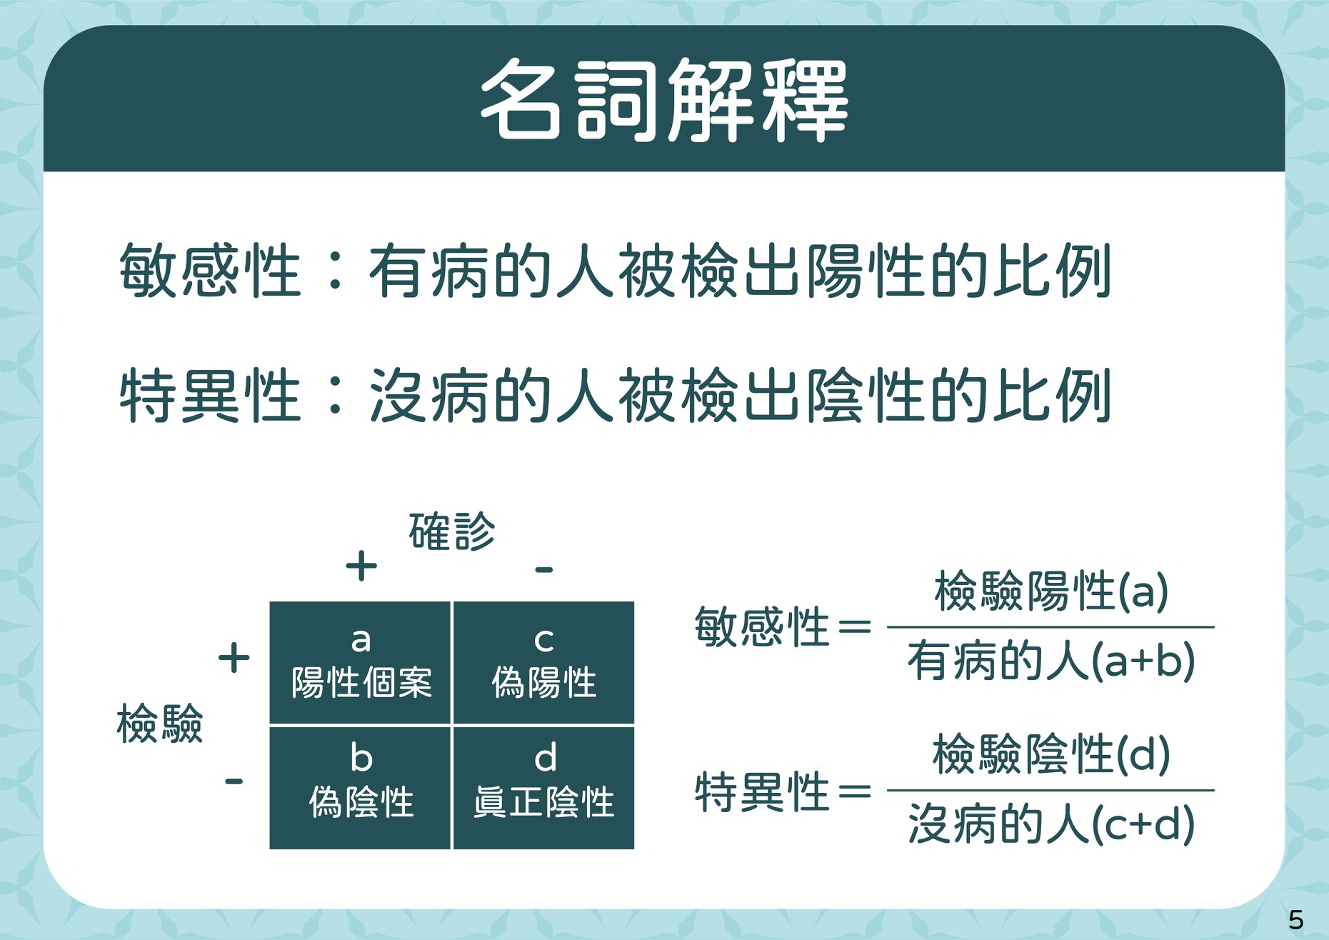
Sensitivity
Specificity
Credit by 疾病管制署 - 1922防疫達人https://www.facebook.com/TWCDC/posts/10158094507103407

Slide 65
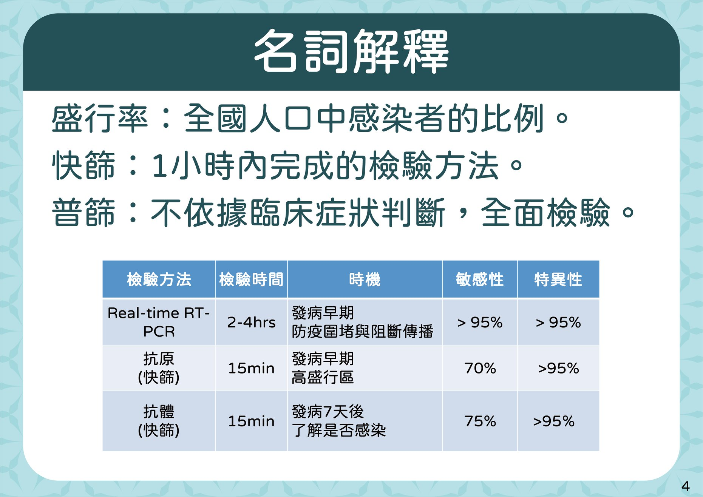
Sensitivity
Specificity
Credit by 疾病管制署 - 1922防疫達人https://www.facebook.com/TWCDC/posts/10158094507103407

Slide 66
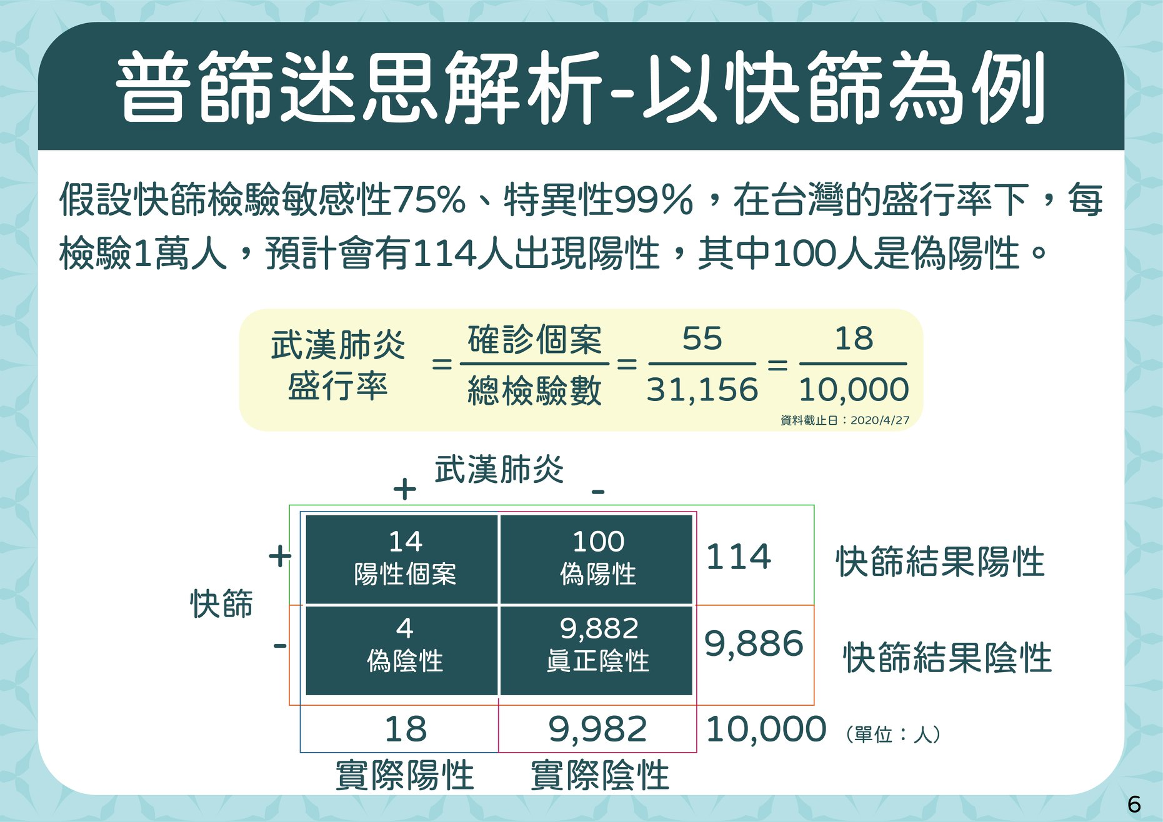
Credit by 疾病管制署 - 1922防疫達人https://www.facebook.com/TWCDC/posts/10158094507103407

Slide 67
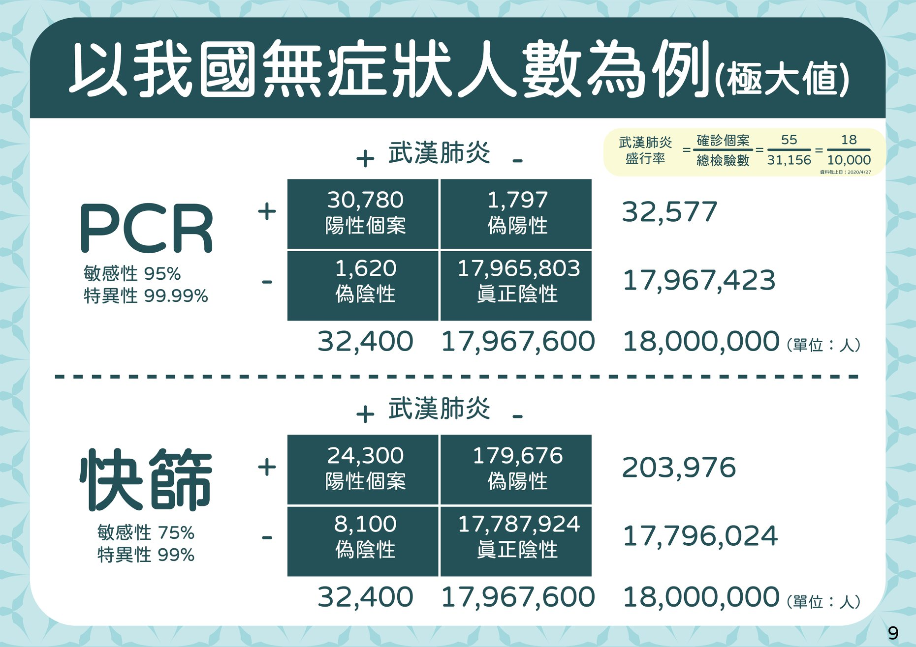
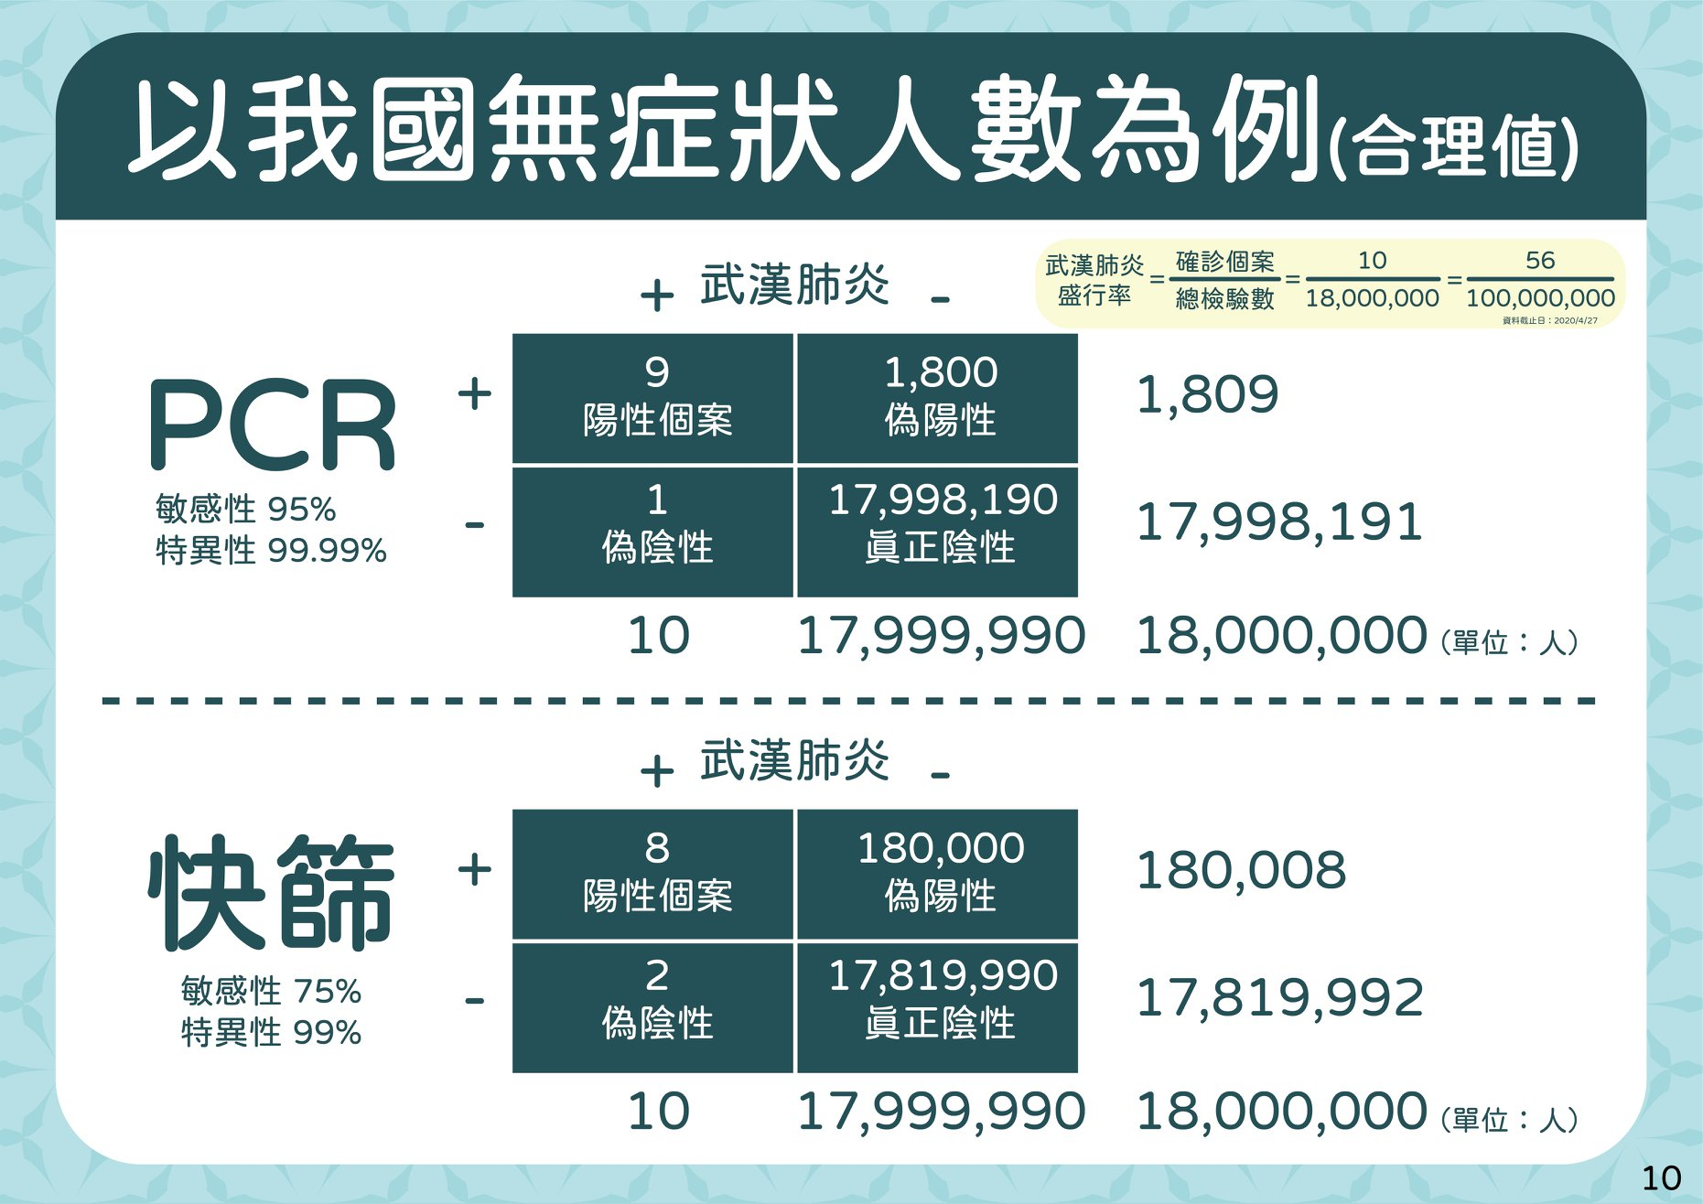
無症狀人數為例
Credit by 疾病管制署 - 1922防疫達人https://www.facebook.com/TWCDC/posts/10158094507103407

Slide 68
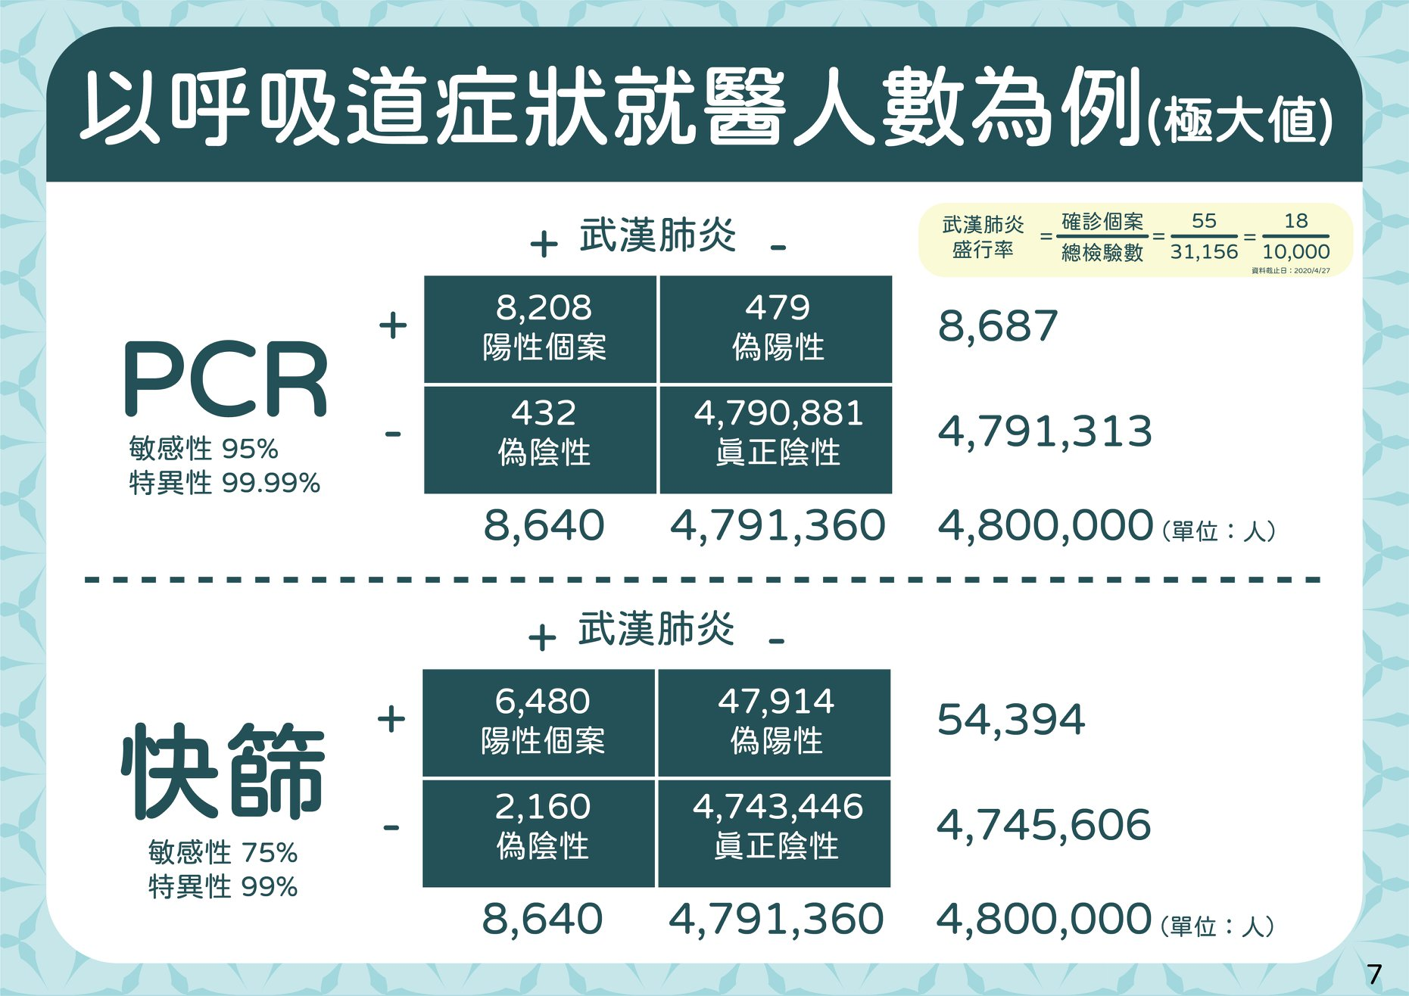
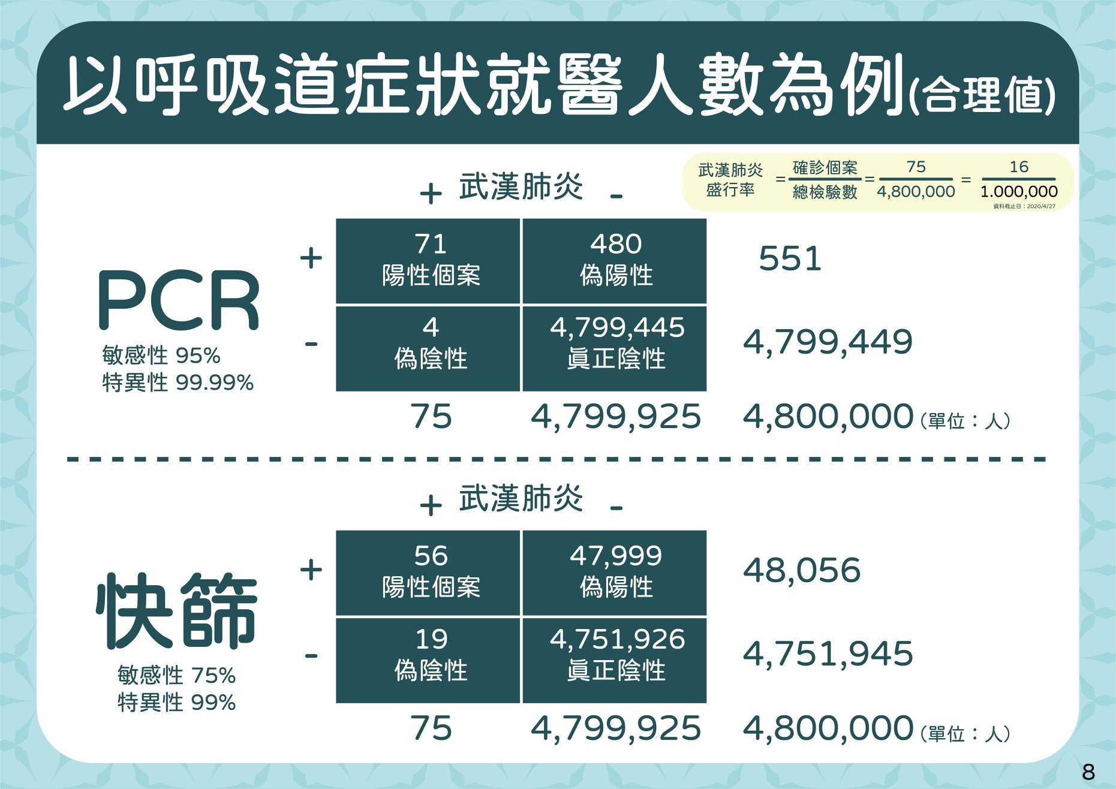
呼吸道就醫人數
Credit by 疾病管制署 - 1922防疫達人https://www.facebook.com/TWCDC/posts/10158094507103407

Slide 69
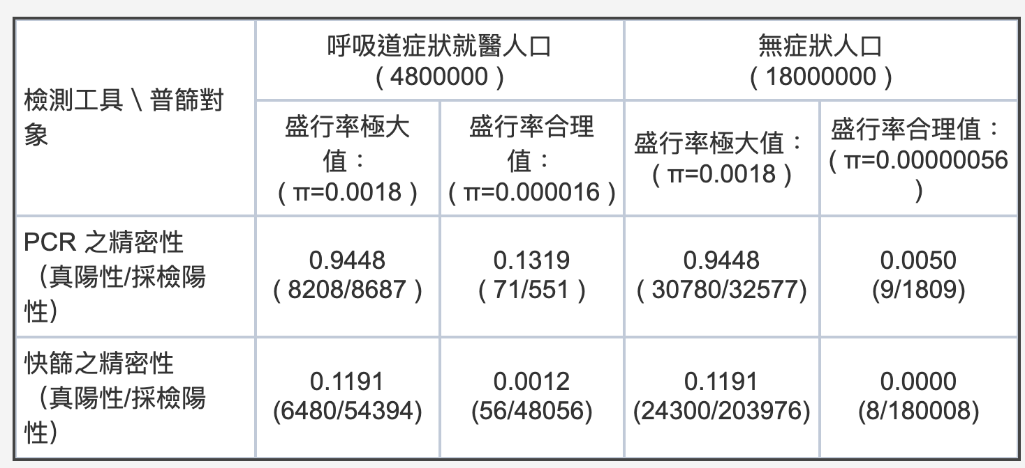
PCR 及快篩的精密性
Credit by 林澤民 https://pansci.asia/archives/185201

Slide 70
Multi-class classification

Slide 71
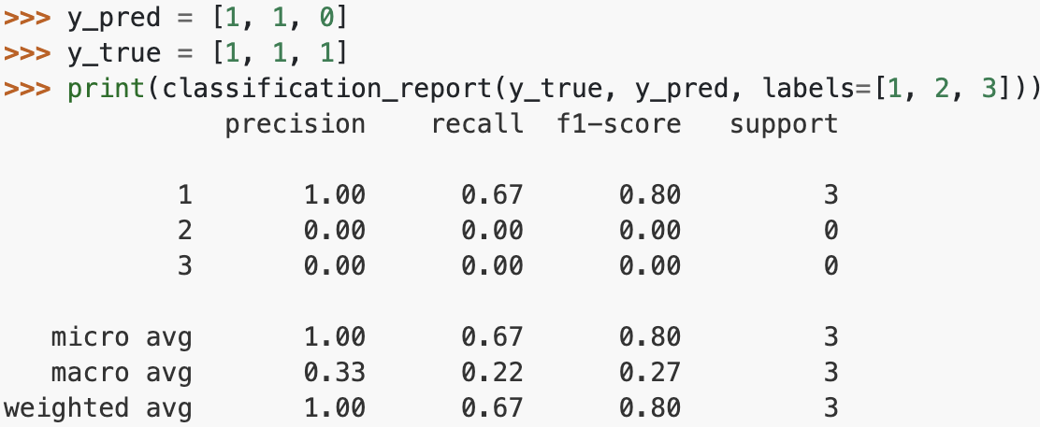
Measurement by sklearn
sklearn.metrics.classification_report
Credit by https://scikit-learn.org/stable/modules/generated/sklearn.metrics.classification_report.html#sklearn.metrics.classification_report
Notes:
sklearn有拿原始的數據去算過跟classification report的結果相符

Slide 72
Convert confusion matrix to binary confusion matrix by class
ex. class 1
 | 1 | 2 | 3 | 4 | 5
1
2
3
4
5
TP
FN
FP
 | 1 | 0
1
0
TN
TP
FN
FP
TN

Slide 73
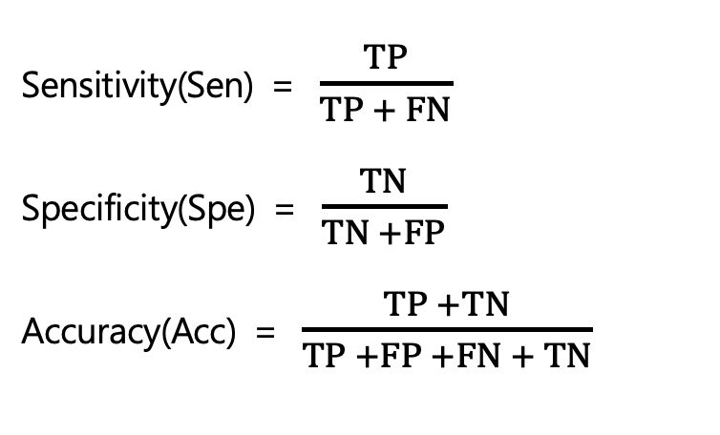
Then calculate Sen, Spe, Acc by class
ex. class 1
Sensitivity(Sen) = $\frac{TP}{TP + FN}$ Specificity(Spe) = $\frac{TN}{TN +FP}$
Accuracy(Acc) = $\frac{TP +TN}{TP +FP +FN + TN}$
 | 1 | 0
1 | TP | FN
0 | FP | TN

Slide 74

Specificity becomes inflated
there are 10 classes with 10 observations each
Sensitive = 8/18 = 44.4%
Specificity = 80/90 = 88.9%
Credit by https://www.datascienceblog.net/post/machine-learning/performance-measures-multi-class-problems/

Slide 75
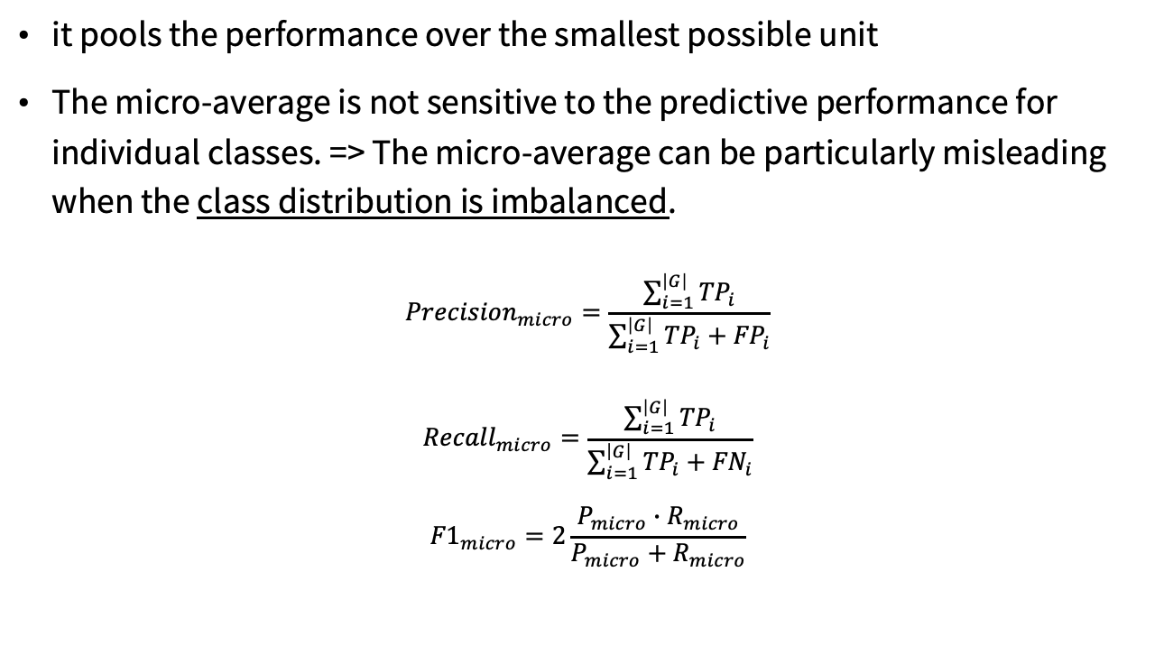
The micro average
it pools the performance over the smallest possible unit
The micro-average is not sensitive to the predictive performance for individual classes. => The micro-average can be particularly misleading when the class distribution is imbalanced.
$${Precision}_{micro}=\frac{\sum_{i=1}^{\left|G\right|}{{TP}_{i}}}{\sum_{i=1}^{\left|G\right|}{{TP}_{i}+{FP}_{i}}}$$
$${Recall}_{micro}=\frac{\sum_{i=1}^{\left|G\right|}{{TP}_{i}}}{\sum_{i=1}^{\left|G\right|}{{TP}_{i}+{FN}_{i}}}$$
$${F1}_{micro}=2\frac{P_{micro}∙R_{micro}}{P_{micro}+R_{micro}}$$

Slide 76
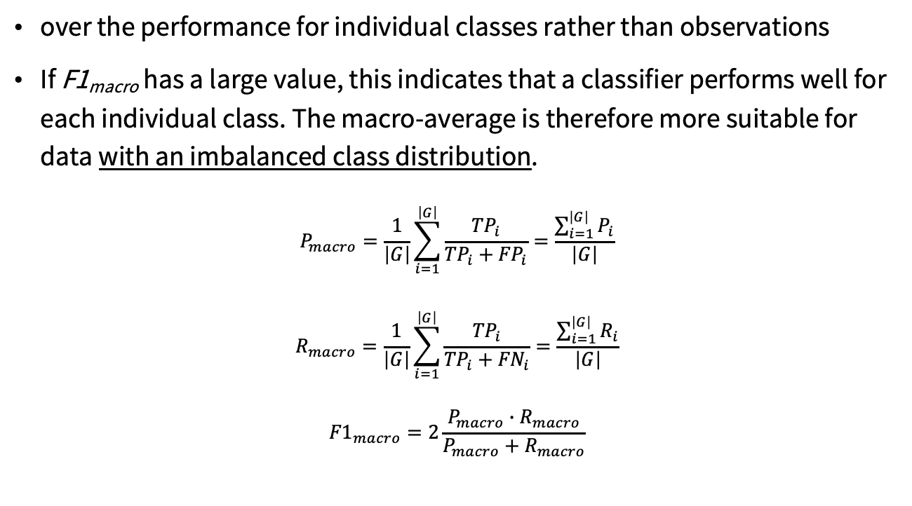
The macro average
over the performance for individual classes rather than observations
If F1_{macro} has a large value, this indicates that a classifier performs well for each individual class. The macro-average is therefore more suitable for data with an imbalanced class distribution.
$$P_{macro}=\frac{1}{\left|G\right|}\sum_{i=1}^{\left|G\right|}{\frac{{TP}_{i}}{{TP}_{i}+{FP}_{i}}=\frac{\sum_{i=1}^{\left|G\right|}{P_{i}}}{\left|G\right|}}$$
$$R_{macro}=\frac{1}{\left|G\right|}\sum_{i=1}^{\left|G\right|}{\frac{{TP}_{i}}{{TP}_{i}+{FN}_{i}}=\frac{\sum_{i=1}^{\left|G\right|}{R_{i}}}{\left|G\right|}}$$
$${F1}_{macro}=2\frac{P_{macro}∙R_{macro}}{P_{macro}+R_{macro}}$$

Slide 77
Evaluating scoring models

Slide 78
Evaluating scoring models
residuals or difference between our predictions and actual outcomes
residual.R
d <- data.frame(y=(1:10)^2,x=1:10)
model <- lm(y~x,data=d)
d$prediction <- predict(model,newdata=d)
library('ggplot2')
ggplot(data=d) + geom_point(aes(x=x,y=y)) +
geom_line(aes(x=x,y=prediction),color='blue') +
geom_segment(aes(x=x,y=prediction,yend=y,xend=x)) + scale_y_continuous('')
Practical Data Science with R by Nina Zumel, John Mount

Slide 79
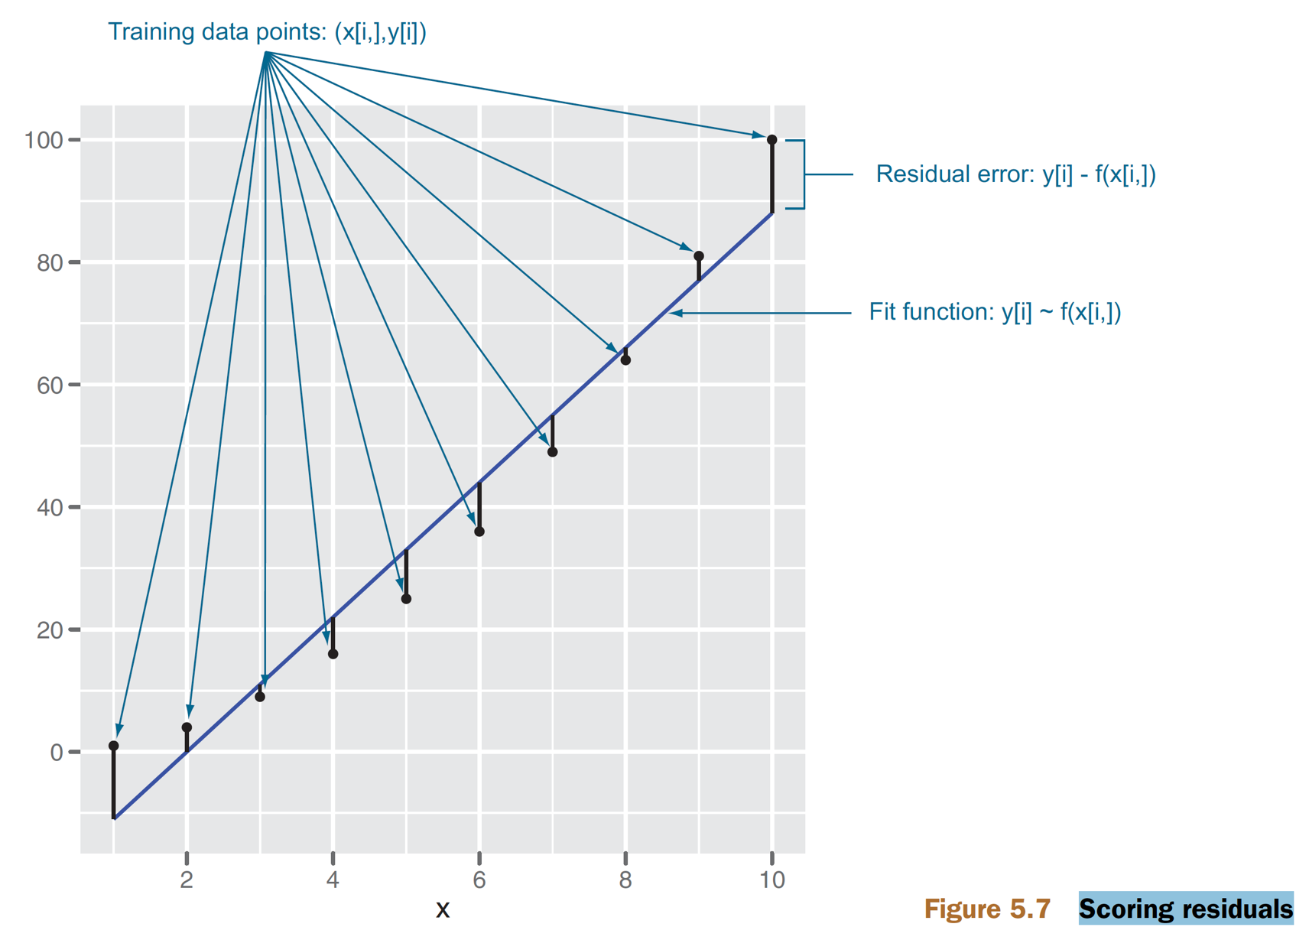
Scoring residuals
Figure 5.7, Practical Data Science with R by Nina Zumel, John Mount

Slide 80
Absolute error
residual.R
absolute error
sum(abs(d$prediction-d$y))
mean absolute error
sum(abs(d$prediction-d$y))/length(d$y)
relative absolute error
sum(abs(d$prediction-d$y))/sum(abs(d$y))
Practical Data Science with R by Nina Zumel, John Mount

Slide 81
Absolute error
three advertisement purchases returning $0, $0, and $25 respectively =>picking a single summary value not too far from the original three prices
0 or 8.33 is better?
Not advisable to make these measures the project goal
Practical Data Science with R by Nina Zumel, John Mount

Slide 82
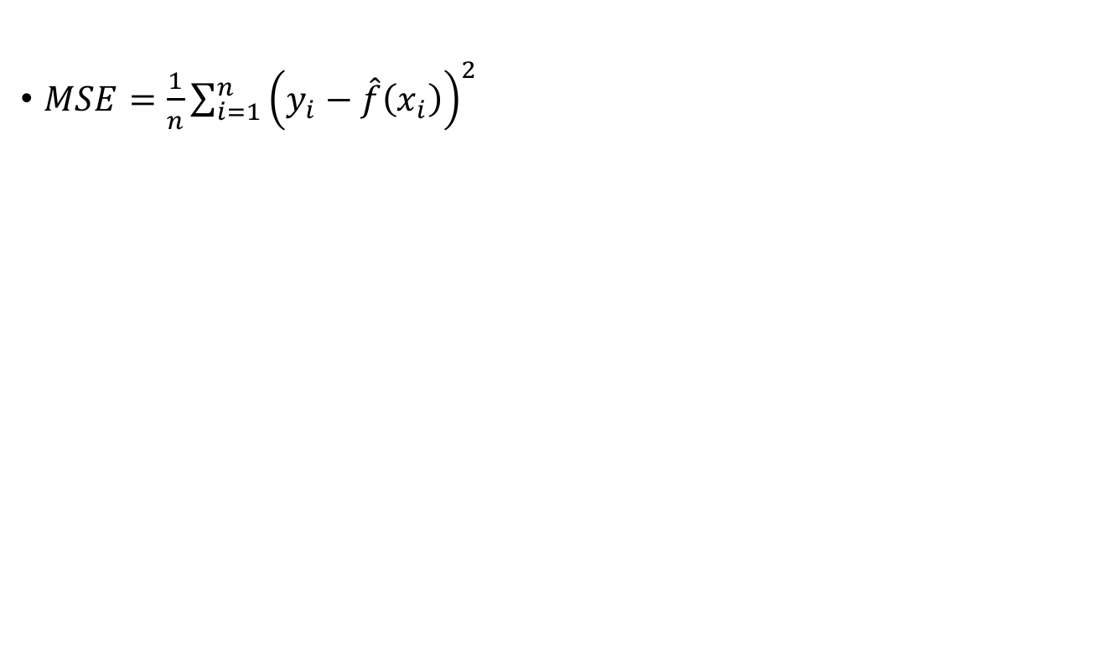
Mean Squared Error
$MSE=\frac{1}{n}\sum_{i=1}^{n}{{\left(y_{i}−\hat{f}\left(x_{i}\right)\right)}^{2}}$
Practical Data Science with R by Nina Zumel, John Mount

Slide 83
Root Mean Square Error (RMSE)
the square root of the average square of the difference between our prediction and actual values
sqrt(mean((prediction-actualValues)^2))
Practical Data Science with R by Nina Zumel, John Mount

Slide 84
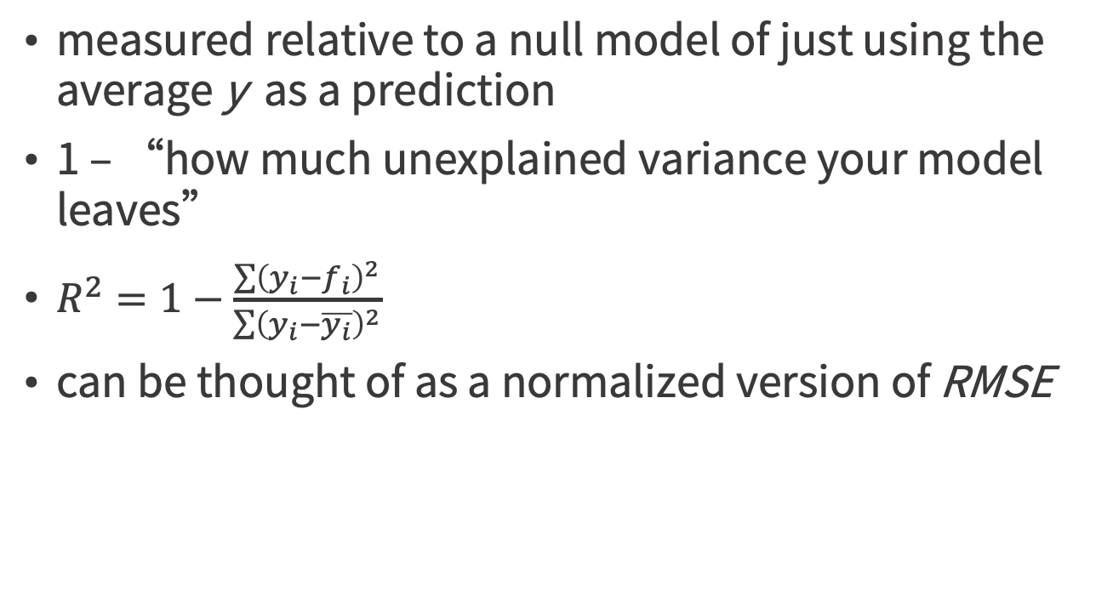
R-Squared, R², the coefficient of determination
measured relative to a null model of just using the average y as a prediction
1 – “how much unexplained variance your model leaves”
$R^{2}=1−\frac{\sum{{\left(y_{i}−f_{i}\right)}^{2}}}{\sum{{\left(y_{i}−\overline{y_{i}}\right)}^{2}}}$
can be thought of as a normalized version of RMSE
Practical Data Science with R by Nina Zumel, John Mount

Slide 85
How to check if a model fit is good?
The R² statistic has become the almost universally standard measure for model fit in linear models.
It is the ratio of error in a model over the total variance in the dependent variable.
1 or 0 better?
Hence the lower the error, the higher the R² value.
A good statement of a R² business goal = We want the model to explain at least 70% of variation in account value.
Dr. Thomas Jensen -Expedia.com and Prof. Olga Veksler - CS9840 - Learning and Computer Vision

Slide 86
R²
close to 1: then the model’s predictions mirror true outcome
is low: then either the model does not mirror true outcome, or it only mirrors it loosely

Slide 87
Correlation
at least three calculations
the Pearson coefficient : checks for linear relations
the Spearman coefficient : checks for rank or ordered relations
the Kendall coefficient: checks for degree of voting agreement.
Practical Data Science with R by Nina Zumel, John Mount​

Slide 88
Correlation
Each of these coefficients performs a progressively more drastic transform than the one before and has well-known direct significance tests
!!!DON’T USE CORRELATION TO EVALUATE MODEL QUALITY IN PRODUCTION
correlation ignores shifts and scaling factors
Practical Data Science with R by Nina Zumel, John Mount

Slide 89
Correlation ignores shifts and scaling factors
a <- c(0.1,0.2)
ignores shifts
b <- c(0.3,0.4)
cor(a,a)
cor(a,b)
ignores scaling
c <- c(0.2, 0.4)
d <- c(0.4,0.8)
cor(a,c)
cor(a,d)
Practical Data Science with R by Nina Zumel, John Mount

Slide 90
R-squared = correlation²
Under general conditions, as Wikipedia says, R² is also the square of the correlation between the actual and predicted outcomes.
How to prove?

Slide 91
Correlation = 0.8, is it good?
A good R-squared business goal would be “We want the model to explain 70% of account value.”
Correlation = 0.8
R² = 0.8*0.8 = 0.64 < 70%
Unexplained variance = 1-0.64 = 0.36

Slide 92
Evaluating probability models

Slide 93
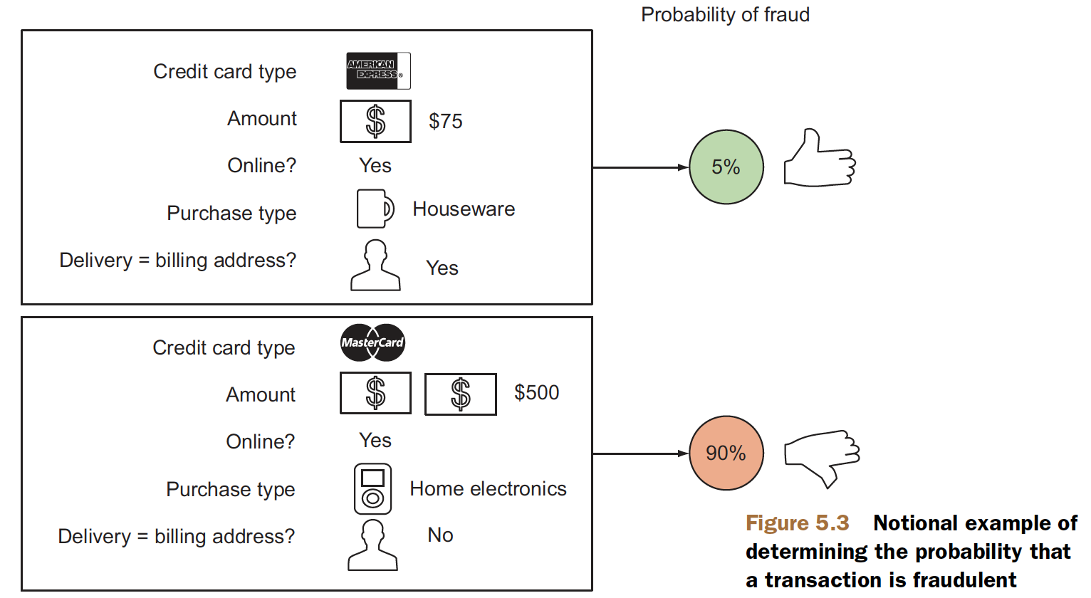
Figure 5.3, Practical Data Science with R by Nina Zumel, John Mount

Slide 94
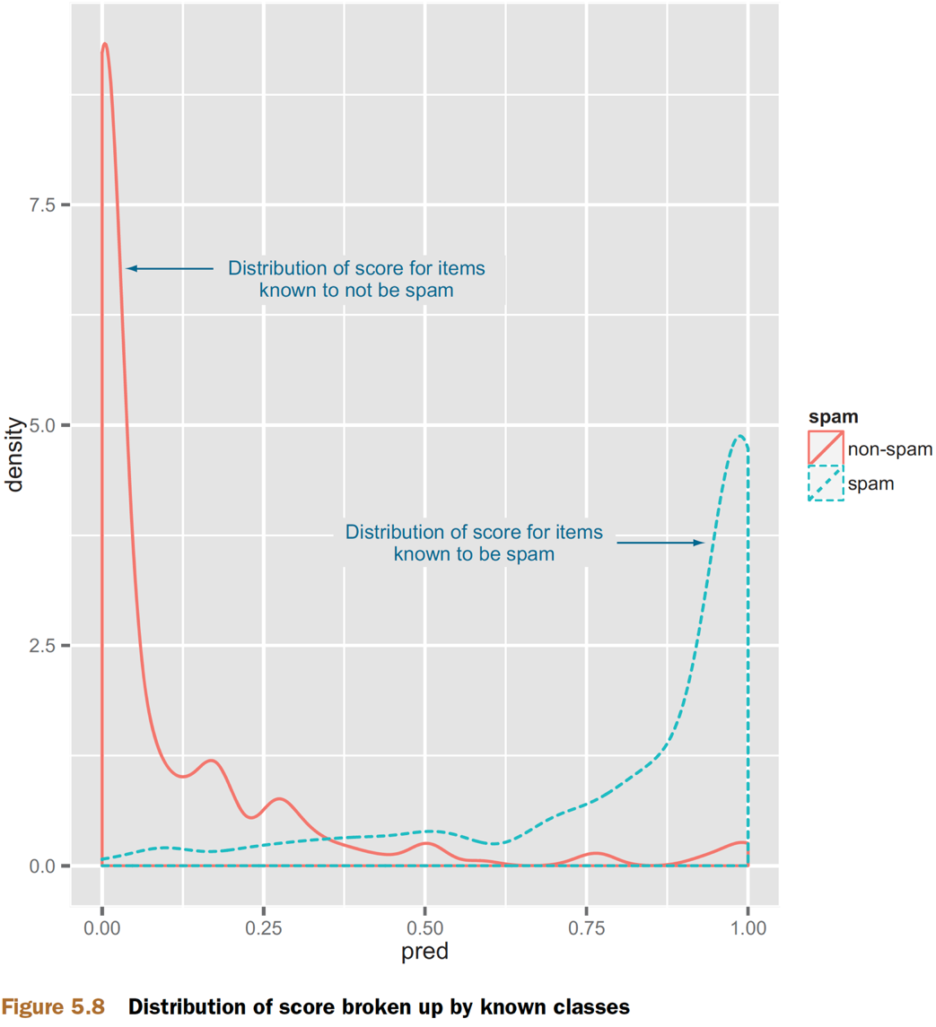
Evaluating probability models
Making a double density plot
ggplot(data=spamTest) + geom_density(aes(x=pred,color=spam,linetype=spam))
Figure 5.8, Practical Data Science with R by Nina Zumel, John Mount

Slide 95
The Receiver Operating Characteristic Curve
ROC curve
by picking a different score threshold between positive and negative determination
represents every possible trade-off between sensitivity and specificity
AUC or area under the curve
1.0 = perfect classifiers
0.5 = do no better than random guesses
Practical Data Science with R by Nina Zumel, John Mount

Slide 96
The Receiver Operating Characteristic Curve
spamExam.R
library('ROCR')
eval <- prediction(spamTest$pred,spamTest$spam)
plot(performance(eval,"tpr","fpr"))
print(attributes(performance(eval,'auc'))$y.values[[1]])
Practical Data Science with R by Nina Zumel, John Mount

Slide 97
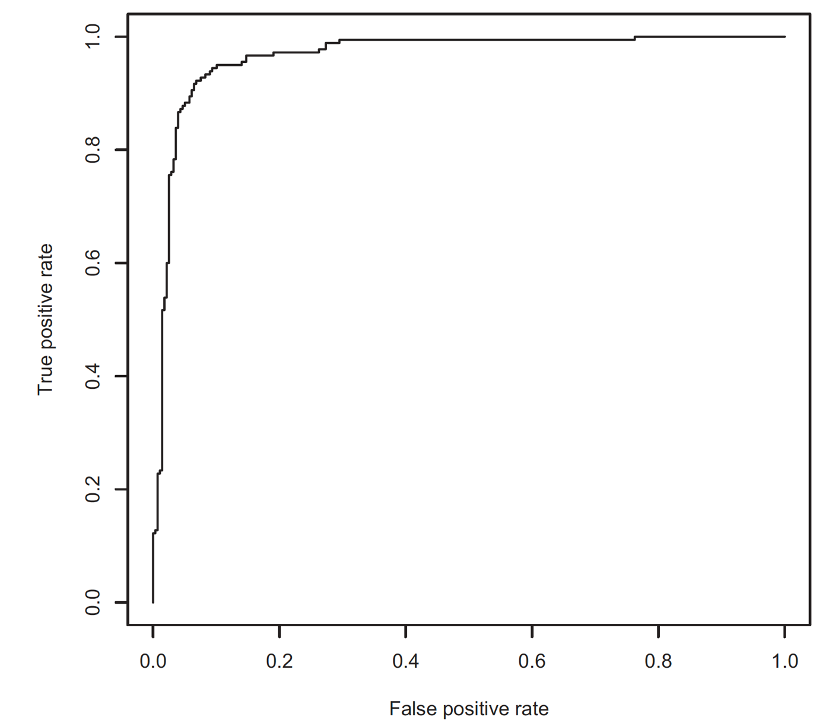
ROC curve
B
A
Figure 5.9, Practical Data Science with R by Nina Zumel, John Mount

Slide 98
More on ROC/AUC
The ROC curve is a useful tool, but you have to use it for appropriate tasks.
The ROC curve is useful tool designing a classifier from a scoring function (though I prefer the “double hump graph”).
Hand, D.J. Measuring classifier performance: a coherent alternative to the area under the ROC curve. Mach Learn 77, 103–123 (2009).
Credit by Win-Vector Blog, http://www.win-vector.com/blog/2013/01/more-on-rocauc/

Slide 99
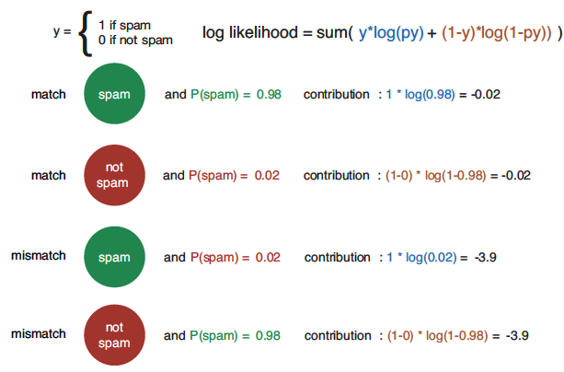
Log Likelihood
the logarithm of the product of the probability the model assigned to each example
a spam with an estimated spam 0.9 => log(0.9)
a non-spam email an estimated spam 0.9 => log(0.1)
0.02
Figure 6.19, Practical Data Science with R by Nina Zumel, John Mount

Slide 100
Log Likelihood
a non-positive number
0 = a perfect match
scores all the spam as being spam with a probability of 1
all the nonspam as having a probability 0 of being spam
The larger the magnitude = the worse the match
Figure 6.19, Practical Data Science with R by Nina Zumel, John Mount

Slide 101
Log Likelihood
spamExam.R
sum(ifelse(spamTest$spam=='spam',
log(spamTest$pred),
log(1-spamTest$pred)))
sum(ifelse(spamTest$spam=='spam',
log(spamTest$pred),
log(1-spamTest$pred)))/dim(spamTest)[[1]]
Practical Data Science with R by Nina Zumel, John Mount

Slide 102
Computing the null model’s log likelihood
spamExam.R
pNull <- sum(ifelse(spamTest$spam=='spam',1,0))/dim(spamTest)[[1]]
sum(ifelse(spamTest$spam=='spam',1,0))*log(pNull) +sum(ifelse(spamTest$spam=='spam',0,1))*log(1-pNull)
-134.9478 better than -306.8952.
Practical Data Science with R by Nina Zumel, John Mount

Slide 103
Deviance
-2*(logLikelihood-S )
where S is a technical constant called “the log likelihood of the saturated model”.
Deviance is unnormalized, so you should only compare deviances that are computed over the same dataset.
The lower the deviance, the better the model.
Practical Data Science with R by Nina Zumel, John Mount

Slide 104
pseudo R-squared
With S = 0, the deviance can be used to calculate a pseudo R-squared (see http://mng.bz/j338)
1 - deviance(model)/deviance(null model)
What is the psedudo R-square of the spam model?
The pseudo R-squared is normalized, so in principle you can compare pseudo R-squareds even when they were computed over different test sets.
prefer models with larger pseudo R-squareds
Practical Data Science with R by Nina Zumel, John Mount

Slide 105
Akaike information criterion (AIC)
deviance + 2*numberOfParameters
deviance penalized for model complexity (more parameters)
useful for
comparing models with different measures of complexity
modeling variables with differing numbers of levels
prefer the model with the smaller AIC
Practical Data Science with R by Nina Zumel, John Mount

Slide 106
Evaluating ranking models

Slide 107
Evaluating ranking models
Ranking models are models that, given a set of examples, sort the rows or assign ranks to the rows.
measured by Spearman’s rank correlation coefficient (treating assigned rank as a numeric score)
Practical Data Science with R by Nina Zumel, John Mount

Slide 108
Evaluating clustering models

Slide 109
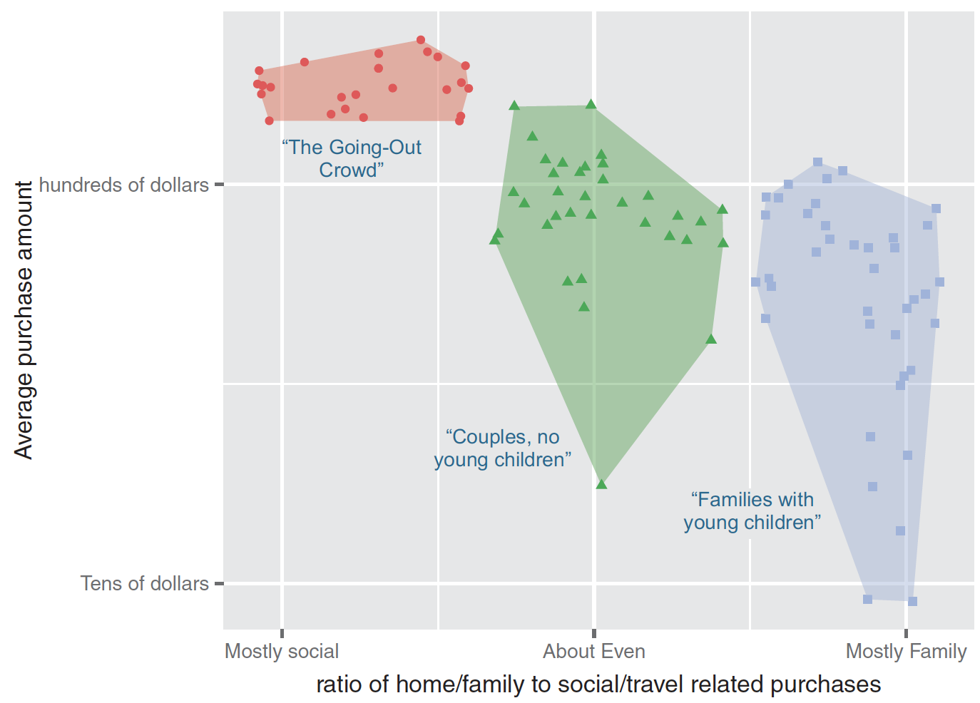
Notional example of clustering your customers by purchase pattern and purchase amount
Figure 5.4, Practical Data Science with R by Nina Zumel, John Mount

Slide 110
Evaluating clustering models
clusterModel.R
Clustering random data in the plane
set.seed(32297)
d <- data.frame(x=runif(100),y=runif(100))
clus <- kmeans(d,centers=5)
d$cluster <- clus$cluster
Calculating the size of each cluster
table(d$cluster)
Practical Data Science with R by Nina Zumel, John Mount

Slide 111
Evaluating clustering models
clusterModel.R
Plotting our clusters
library('ggplot2'); library('grDevices')
h <- do.call(rbind,
lapply(unique(clus$cluster),
function(c) { f <- subset(d,cluster==c); f[chull(f),]}))
ggplot() +
geom_text(data=d,aes(label=cluster,x=x,y=y,
color=cluster),size=3) +
geom_polygon(data=h,aes(x=x,y=y,group=cluster,fill=as.factor(cluster)),
alpha=0.4,linetype=0) +
theme(legend.position = "none")
Practical Data Science with R by Nina Zumel, John Mount

Slide 112
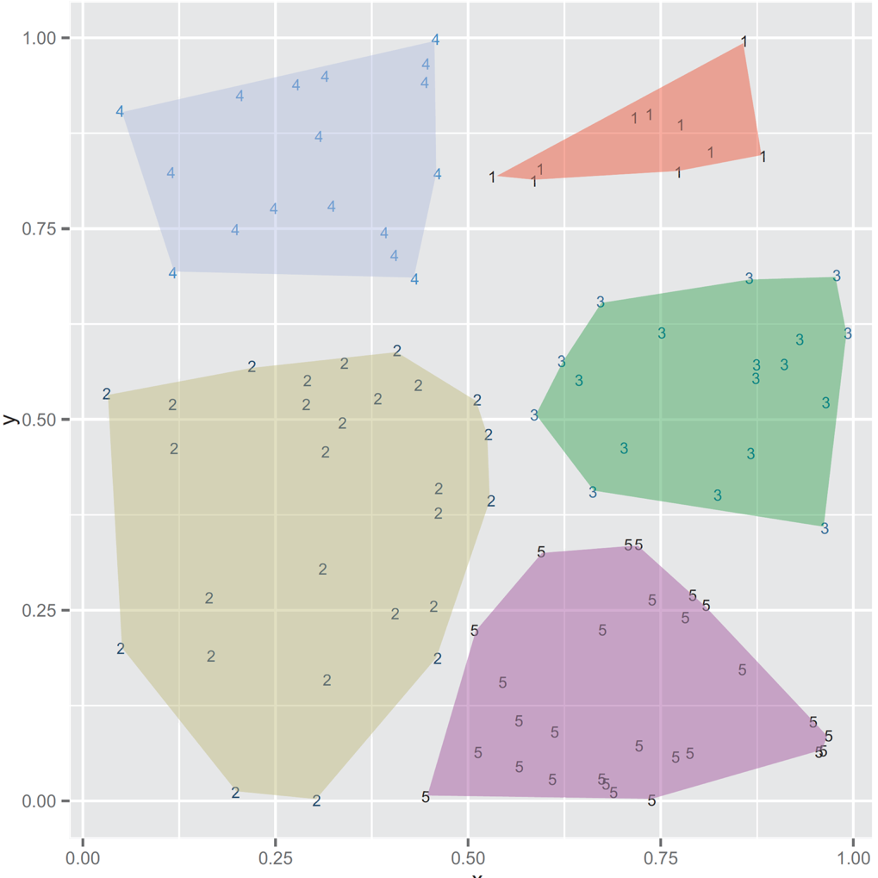
Clustering example
hair clusters : clusters with very few points
waste clusters : clusters with a very large number of points
Figure 5.10, Practical Data Science with R by Nina Zumel, John Mount

Slide 113
Internal / External validations
Internal
use only the data and the clustering results to measure the goodness of fit of the clusters
External
compare the clustering results with a predefined of the data (i.e., class labels)

Slide 114
Internal
Without labels

Slide 115
Intra-cluster distances v.s. Cross-cluster distances
Calculating the typical distance between items in every pair of clusters
library('reshape2')
n <- dim(d)[[1]]
pairs <- data.frame(
ca = as.vector(outer(1:n,1:n,function(a,b) d[a,'cluster'])),
cb = as.vector(outer(1:n,1:n,function(a,b) d[b,'cluster'])),
dist = as.vector(outer(1:n,1:n,function(a,b)
sqrt((d[a,'x']-d[b,'x'])^2 + (d[a,'y']-d[b,'y'])^2)))
)
dcast(pairs,ca~cb,value.var='dist',mean)
intra-cluster distances (the diagonal elements of the table) < inter-cluster distances (the off-diagonal elements of the table)
Practical Data Science with R by Nina Zumel, John Mount

Slide 116
Internal metrics
maximize the inter-cluster distance
minimize the intra-cluster distance
metrics
Calinski-Harabasz index, 1974
details @ topic08_unsupervised.pptx
Silhouette, 1987

Slide 117
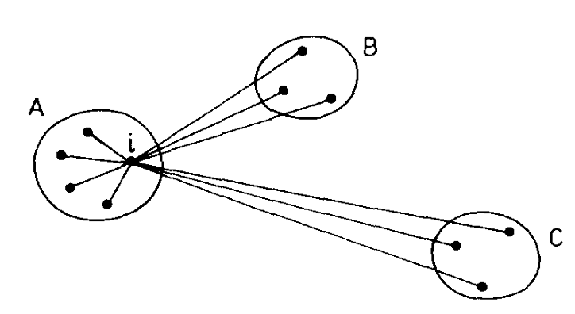
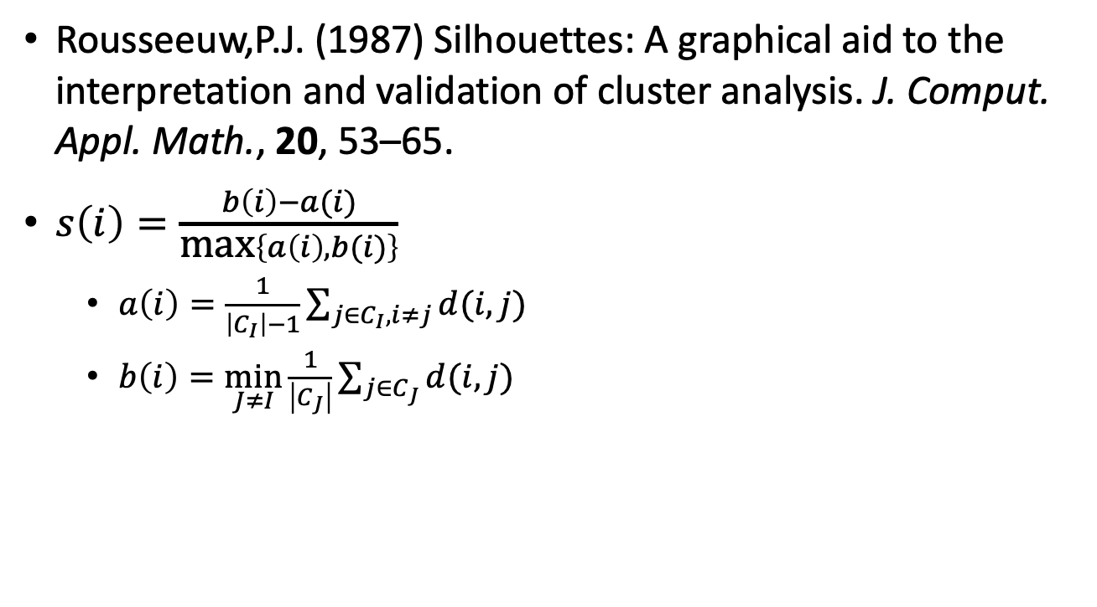
Silhouette
Rousseeuw,P.J. (1987) Silhouettes: A graphical aid to the interpretation and validation of cluster analysis. J. Comput. Appl. Math., 20, 53–65.
$s\left(i\right)=\frac{b\left(i\right)−a(i)}{\text{max}\left\{a\left(i\right),b(i)\right\}}$
$a\left(i\right)=\frac{1}{\left|C_{I}\right|−1}\sum_{j∈C_{I},i≠j}{d(i,j)}$
$b\left(i\right)=\min_{J≠I}{\frac{1}{\left|C_{J}\right|}\sum_{j∈C_{J}}{d(i,j)}}$
Fig 1 from Rousseeuw,P.J. (1987) J. Comput. Appl. Math.

Slide 118

The range of Silhouette
1: appropriately clustered
0: overlapping clusters
-1: i would be more appropriate if it was clustered in its neighbouring cluster
$$s\left(i\right)=\left\{\begin{aligned}1−{a(i)}/{b\left(i\right), ifa\left(i\right)>b(i)} \\ 0, ifa\left(i\right)=b(i) \\ {b\left(i\right)}/{a\left(i\right)}−1, if b\left(i\right)>a(i)\end{aligned}\right.$$

Slide 119
External
With labels

Slide 120
External metrics
Measure the similarity or agreement between the clustering and the external partition
0 ~ 1: 1 = a perfect match
Normalized Mutual Information

Slide 121
Normalized Mutual Information (NMI)
comparison of two partitions even when a different number of clusters
NMI depends on the
Mutual Information I
accounts to the “amount of information” one can extract from a distribution regarding a second one
the entropy of the labeled H(Y) and clustered set H(C).

Slide 122

Normalized Mutual Information (NMI)
$$NMI\left(Y,C\right)=\frac{2×I(Y;C)}{[H\left(Y\right)+H(C)]}$$
Y = class labels
C = cluster labels
H (.) = entropy
$H\left(X\right)=−\sum_{i=1}^{\left|X\right|}{p(i)\log_{2}{p(i)}}$
I (Y ;C ) = mutual information b/w Y & C
$$I\left(Y;C\right)=H\left(Y\right)−H(Y|C)$$

Slide 123
Example1
How many class labels?
How many cluster?
1
2
3
cluster1
cluster2

Slide 124

H(Y)
$H\left(Y\right)=−\frac{1}{4}\log\left(\frac{1}{4}\right)−\frac{1}{4}\log\left(\frac{1}{4}\right)$ $−\frac{1}{2}\log\left(\frac{1}{2}\right)=1.5$
1
2
3
cluster1
cluster2

Slide 125

H(C)
$H\left(C\right)=−\frac{1}{2}\log\left(\frac{1}{2}\right)$ $−\frac{1}{2}\log\left(\frac{1}{2}\right)=1$
1
2
3
cluster1
cluster2

Slide 126

I(Y;C)
$$I\left(Y;C\right)=H\left(Y\right)−H\left(Y | C\right)$$
$H(Y|C)$ : the reduction in the entropy of class labels that we get if we know the cluster labels
1
2
3
cluster1
cluster2

Slide 127

H(Y|C): conditional entropy of class labels for clustering C
$$H\left(Y=1 | C=1\right)=0.3$$
$$H\left(Y | C=1\right)=−P\left(C=1\right)\sum_{y∈\left\{1,2,3\right\}}{P\left(Y=y | C=1\right)\log\left(P\left(Y=y | C=1\right)\right)}=0.7855$$
1
2
3
cluster1

Slide 128

H(Y|C): conditional entropy of class labels for clustering C=2
$$H\left(Y | C=2\right)=−P\left(C=2\right)\sum_{y∈\left\{1,2,3\right\}}{P\left(Y=y | C=2\right)\log\left(P\left(Y=y | C=1\right)\right)}=0.5784$$
1
2
3
cluster2

Slide 129

NMI
$$I\left(Y;C\right)=H\left(Y\right)−H\left(Y | C\right)$$
$$I\left(Y;C\right)=1.5−\left(0.7855+0.5784\right)=0.1361$$
$$NMI\left(Y,C\right)=\frac{2×I(Y;C)}{[H\left(Y\right)+H(C)]}=\frac{2×0.1361}{1.5+1}=0.1089$$

Slide 130
NMI property
This metric is dependent or independent?
of the absolute values of the labels
a permutation of the class or cluster label values won’t change the score value in any way
If we have to compare two clustering that have different number of clusters we can still use NMI. => it’s normalized
Credit by Bilal Ahmed, Behrakis Health Sciences Center

Slide 131


Thank You Any Question?

